Slide 1


R for
health data science

Slide 2


Who are we?
Mikkel Werling, MS
Health data scientist
Your TA for RealWorld
PhD trainee, Rigshospitalet
Mikkel.werling@region.dk
Jennifer Bartell, PhD
Health Data Science Sandbox project manager
Center for Health Data Science @ KU SUND
bartell@sund.ku.dk

Slide 3

Agenda for today
CREDITS
Computing on an HPC platform
Intro to R/RStudio
- Short lectures + exercise sessions
Tips for health data analysis in R
Exercises & many slides were borrowed/adapted from:
‘From Excel to R’
by the SUND Data Lab
heads.ku.dk/datalab

Slide 4
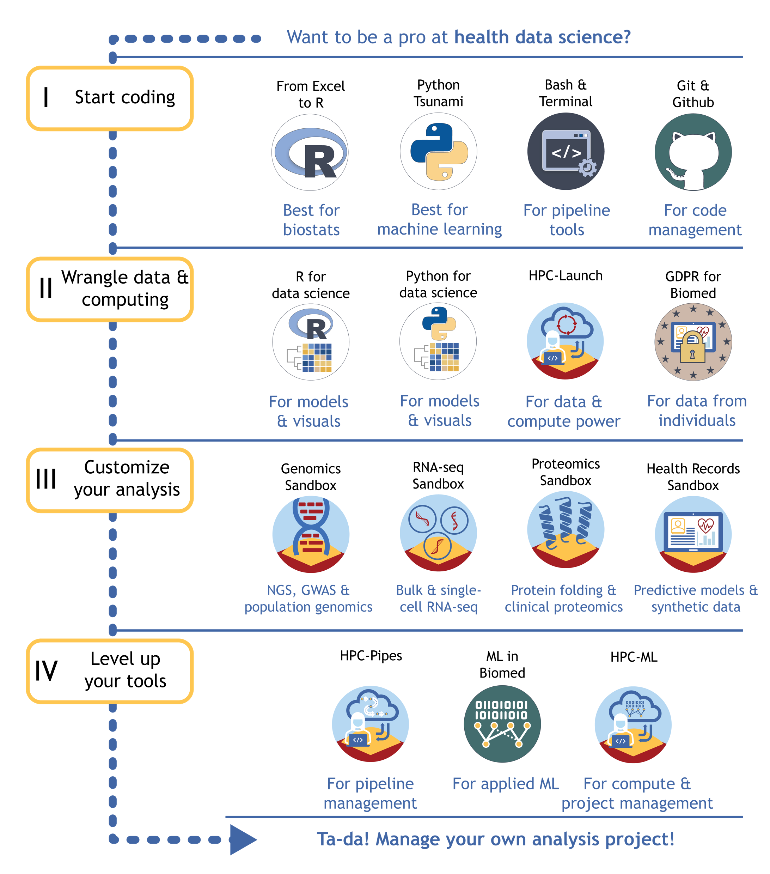
Training from KU’s Center for Health Data Science
Agenda for today
Computing on an HPC platform
Intro to R/RStudio
- Short lectures + exercise sessions
Tips for health data analysis in R

Slide 5

Introductory poll
Experience with coding in R/RStudio?
Experience with working on servers or HPC platforms?
Experience with building models from health data?

Slide 6

What is high performance computing (HPC?)
Using a supercomputer or cluster of computers to perform jobs too computationally intensive for a personal computer
Quantum mechanics
Complex physical simulations (CFD)
Weather forecasting
Molecular modeling
Machine learning / LLMs

Slide 7






What is high performance computing (HPC?)
GPU-based tasks
Compute-heavy tasks
RAM-heavy tasks
Using a ( supercomputer | cluster of computers | server ) to perform jobs too computationally intensive for a personal computer
Quantum mechanics
Complex physical simulations (CFD or other 4D modeling)
Weather forecasting
Molecular modeling
Machine learning / LLMs
Data-heavy tasks
Safely shared tasks

Slide 8
Why do you need to use an HPC platform for this course?
Shareability
- Group work can be done in a shared folder so everyone accesses the same files
Scalability
- You can easily upgrade your job’s compute resources beyond laptop power i.e. number of CPUs
Reproducibility
Same tool versions & dependencies
Same master files
Same compute resources
Safety
We can monitor whether you’re using resources effectively & troubleshoot
Good practice for sensitive data projects

Slide 9
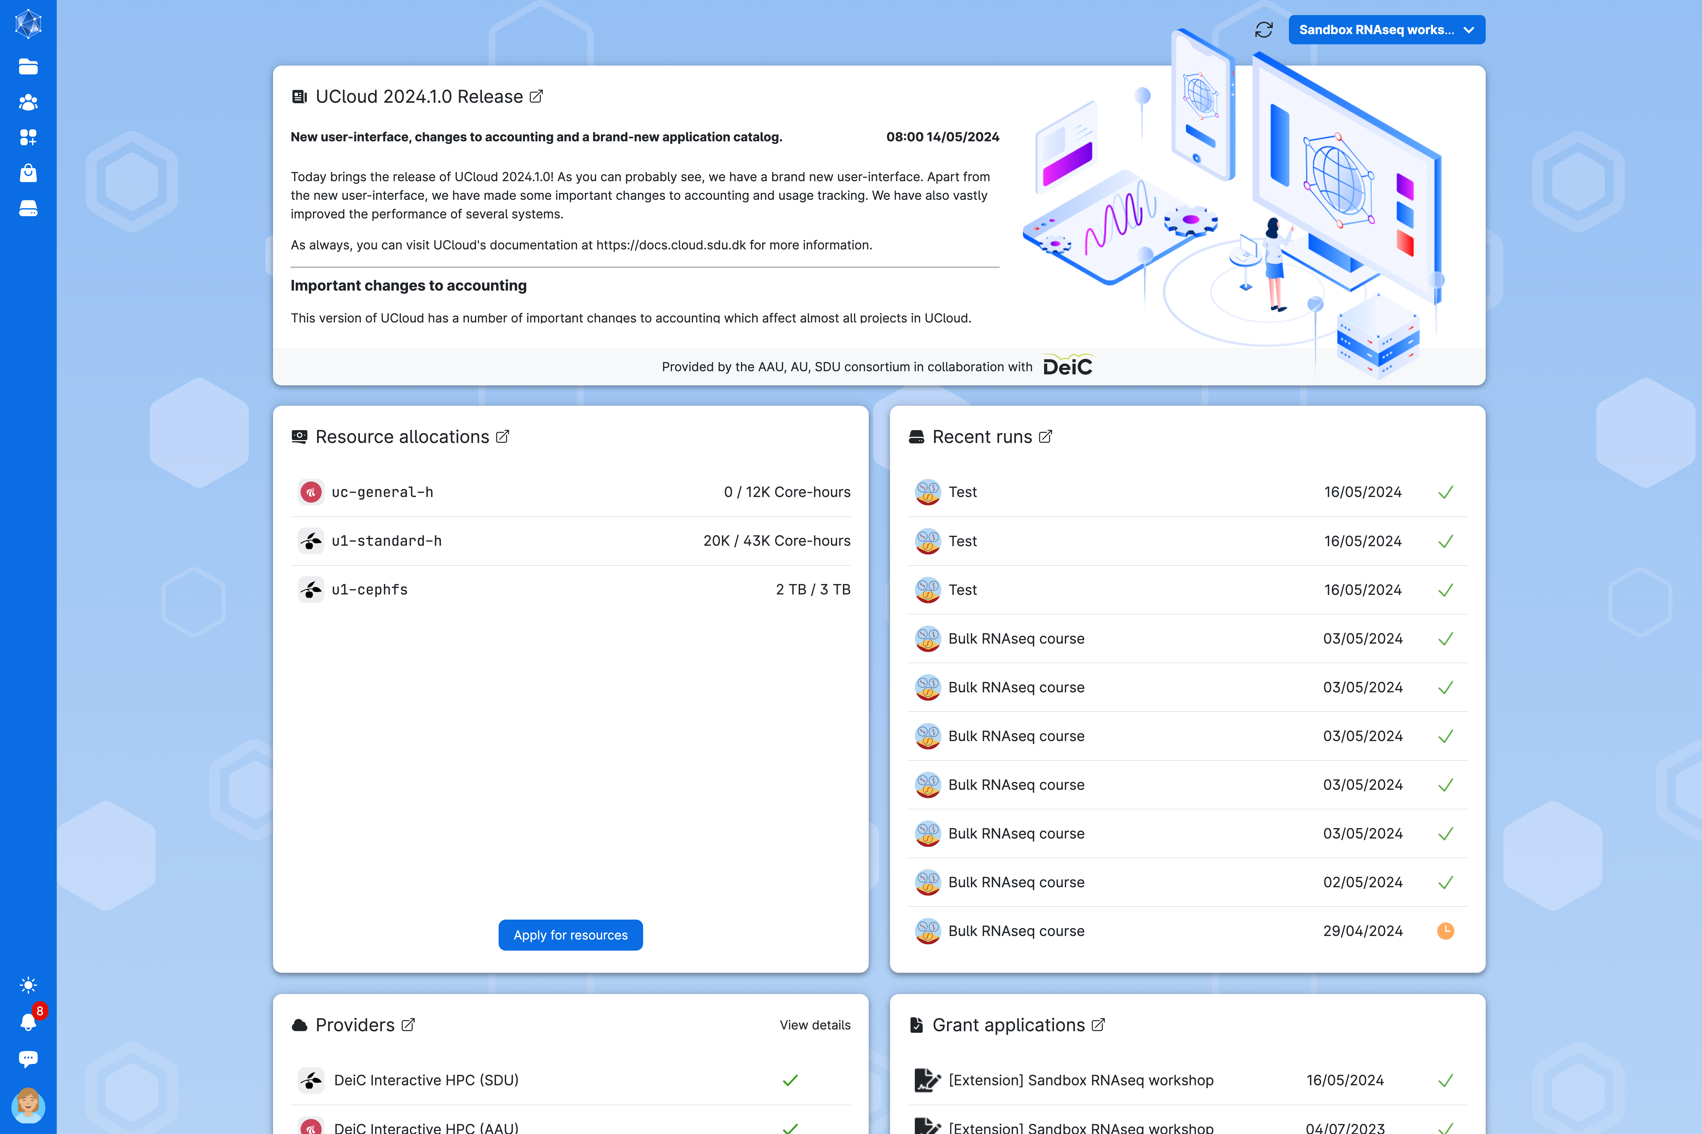
Interactive HPC
with UCloud
Graphical dashboard providing access to storage, compute resources, and project management

Slide 10
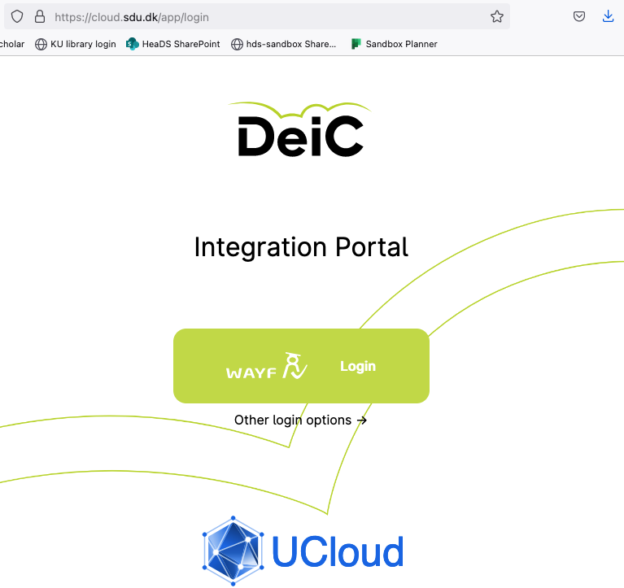
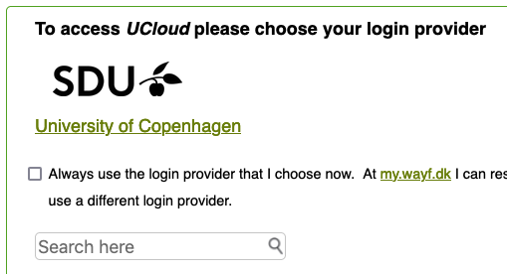

Interactive HPC with UCloud
1. Search & then click on link
2. Sign-in via KU portal

Slide 11

Interactive HPC with UCloud
You’ve been sent a UCloud project invite from From Realworld Data Til Personlig Medicin!

Slide 12
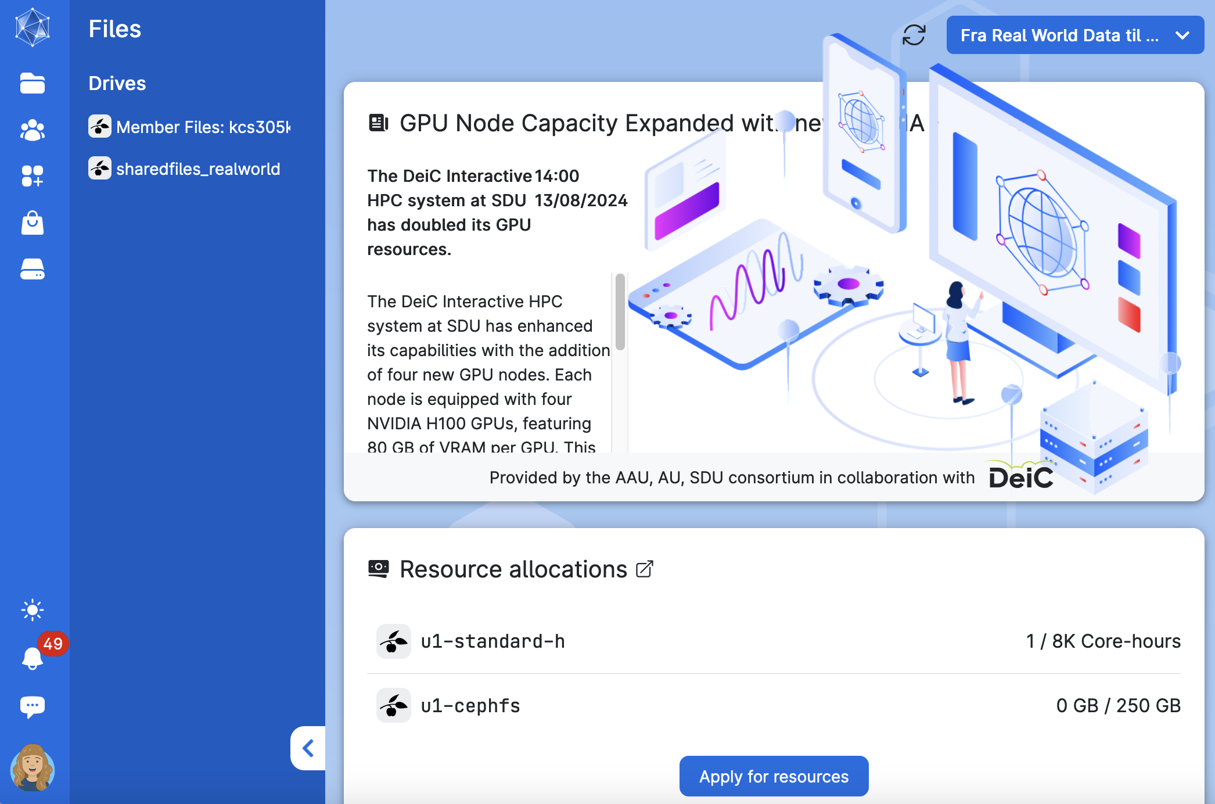
Interactive HPC
with UCloud
Graphical dashboard providing access to storage, compute resources, and project management

Slide 13
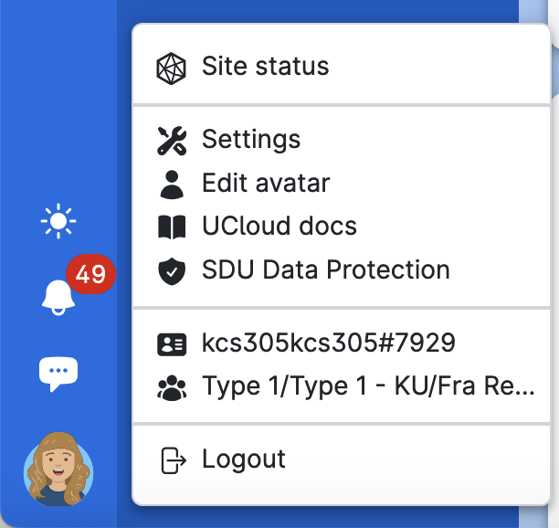
Interactive HPC
with UCloud
Graphical dashboard providing access to storage, compute resources, and project management

Slide 14
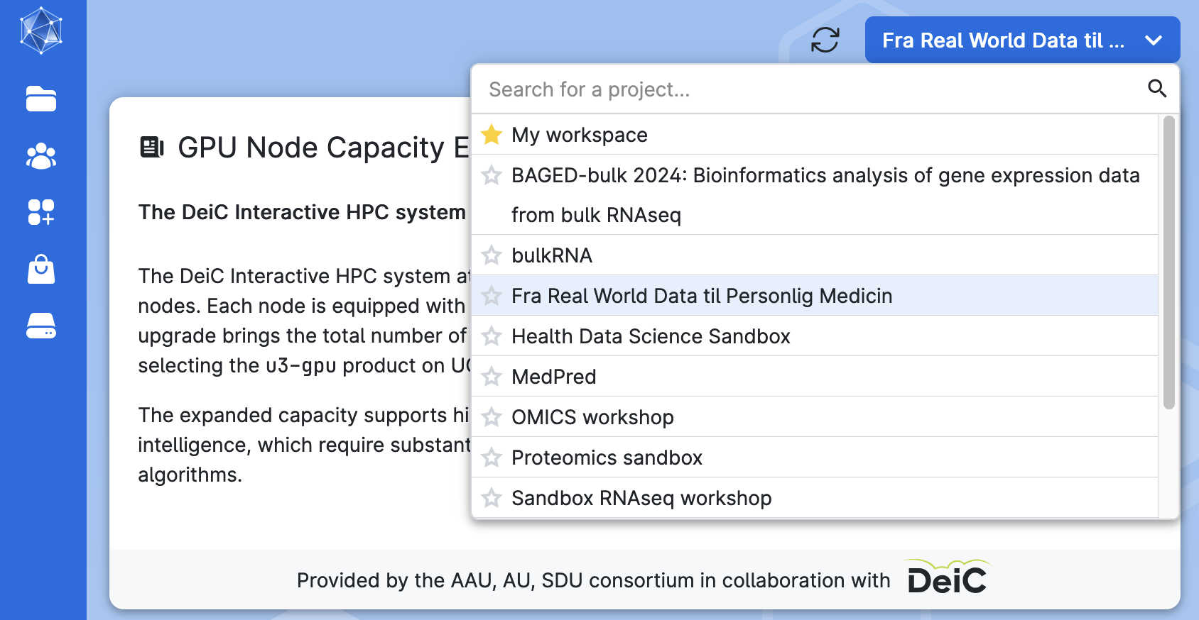
Workspaces
1
Virtual workspaces allow you to share resources and work together with project collaborators
First, you have your own private workspace – new users get some free compute to burn

Slide 15
Workspaces
1
2
Virtual workspaces allow you to share resources and work together with project collaborators
Project folders and files that only belong to the active workspace will be accessible from the Drives menu

Slide 16
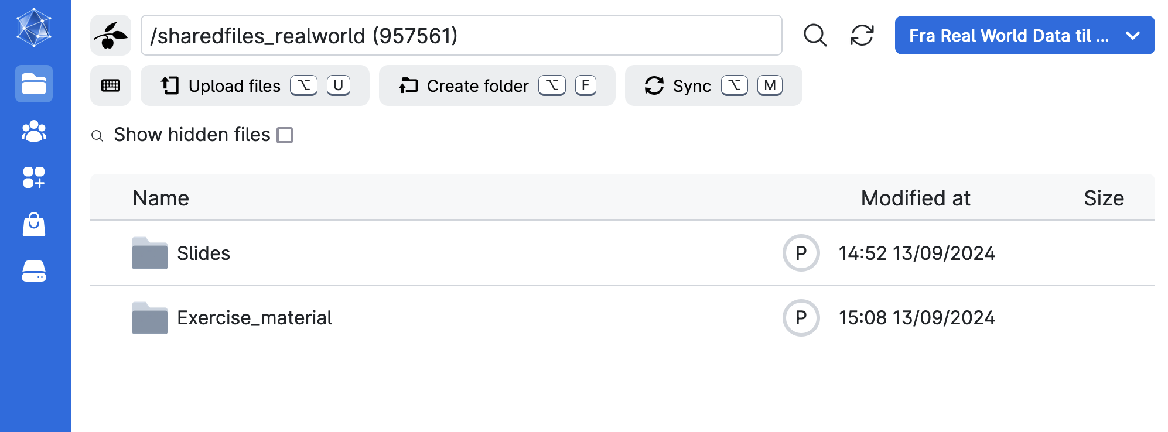
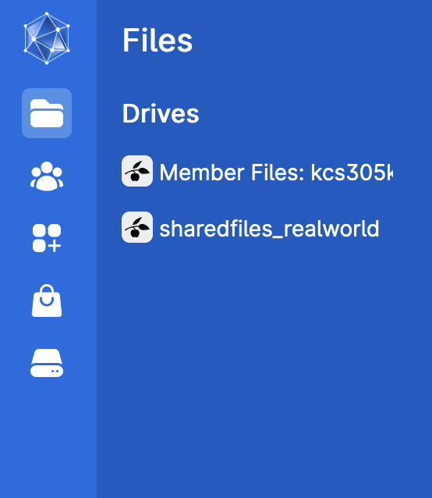
Drives
Your Drives menu should look similar to this

Slide 17
Drives
sharedfiles_realworld is the folder where we share resources with you

Slide 18
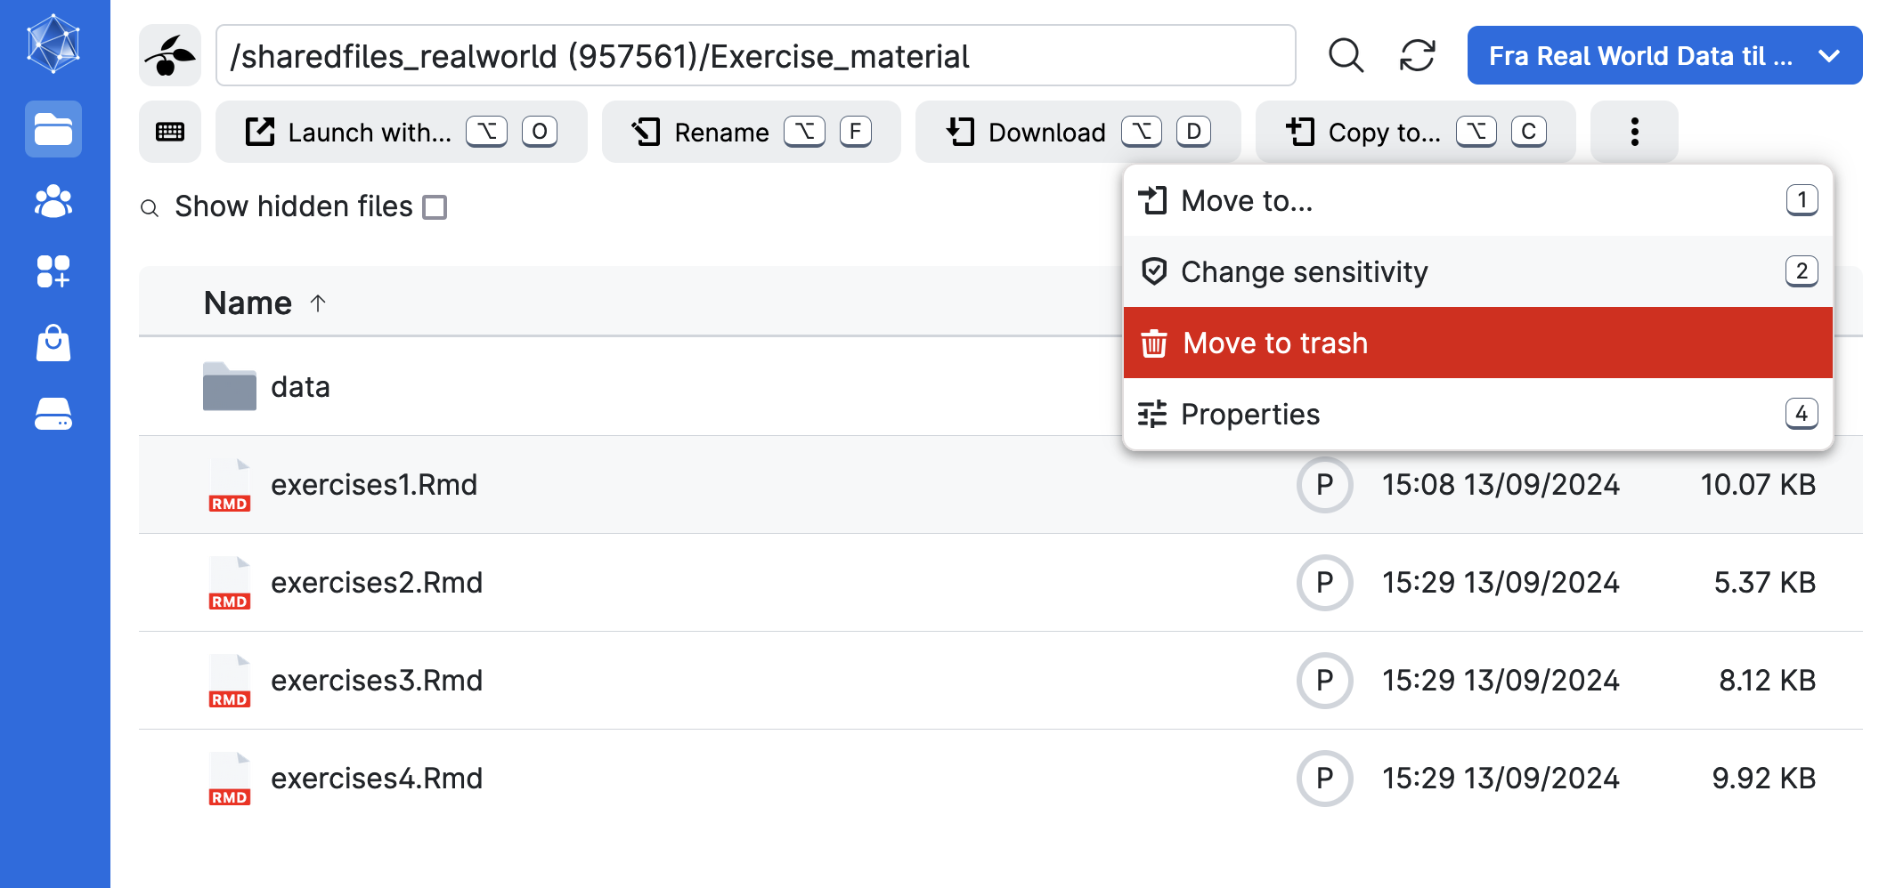
File management
1
2

Slide 19
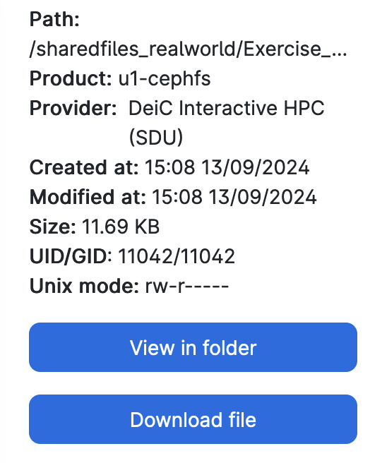
File management
You cannot write to / save these files – they are the shared master versions for everyone

Slide 20
File management
If you want to save changes, you need to make your own copy!
Let’s do it together.

Slide 21
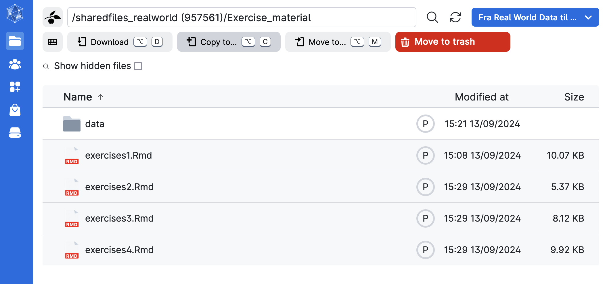
File management – copying files & folders
2
1
Select x4 and then Copy to…

Slide 22
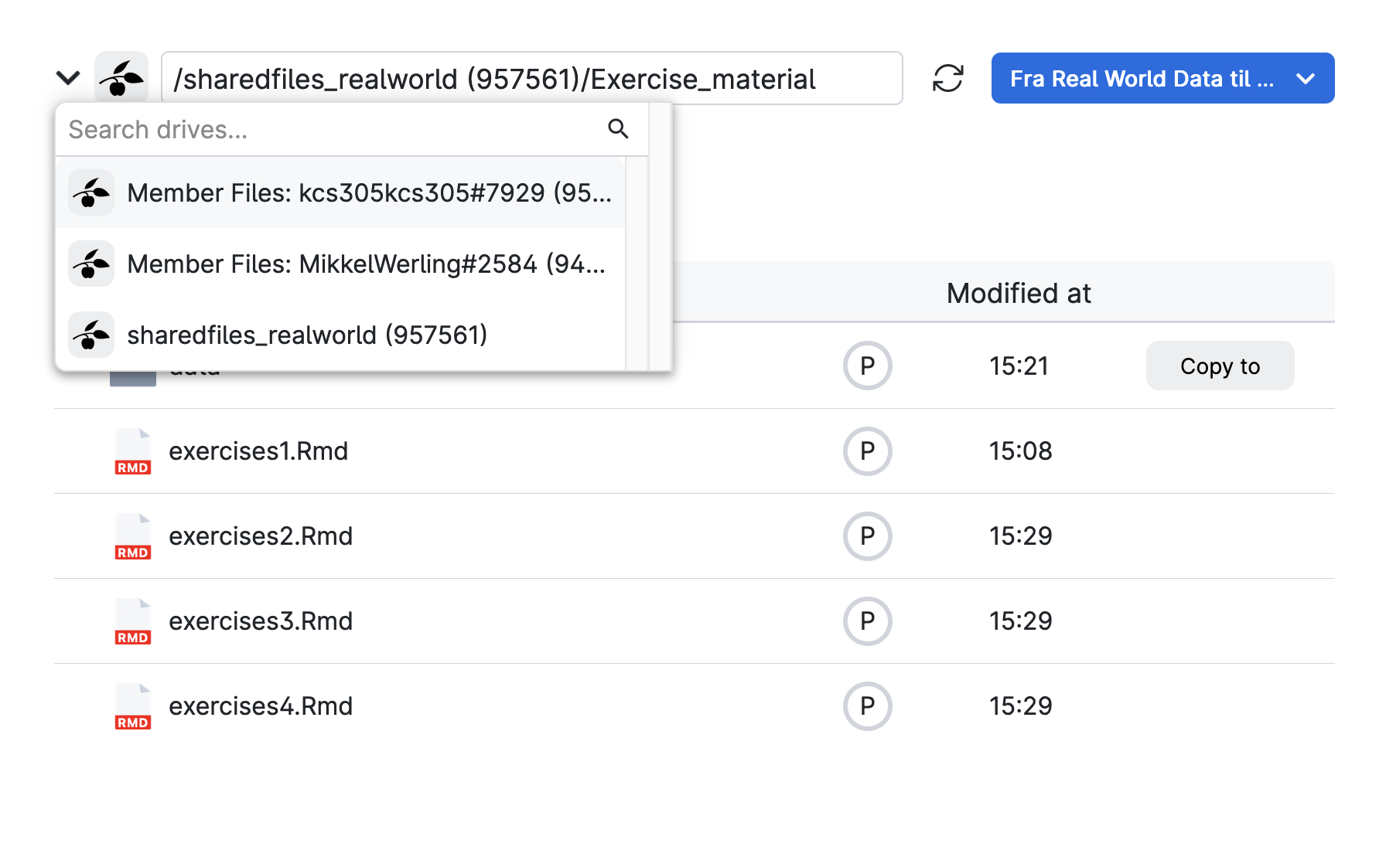
File management – copying files & folders
1
Switch to your personal drive where you have write permissions
2

Slide 23
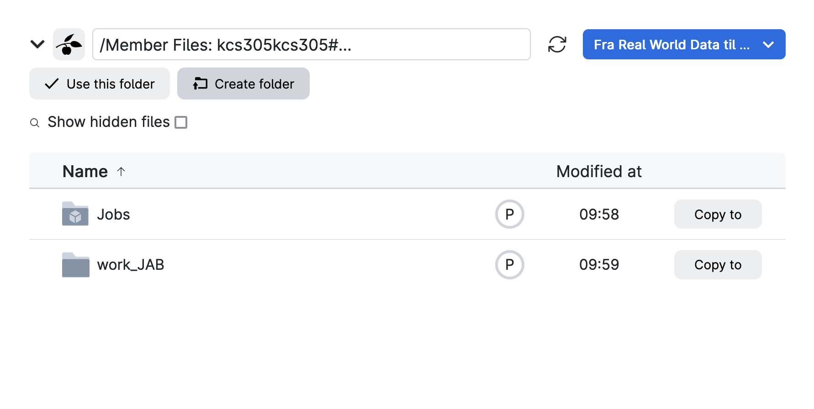
File management – copying files & folders
1
2

Slide 24
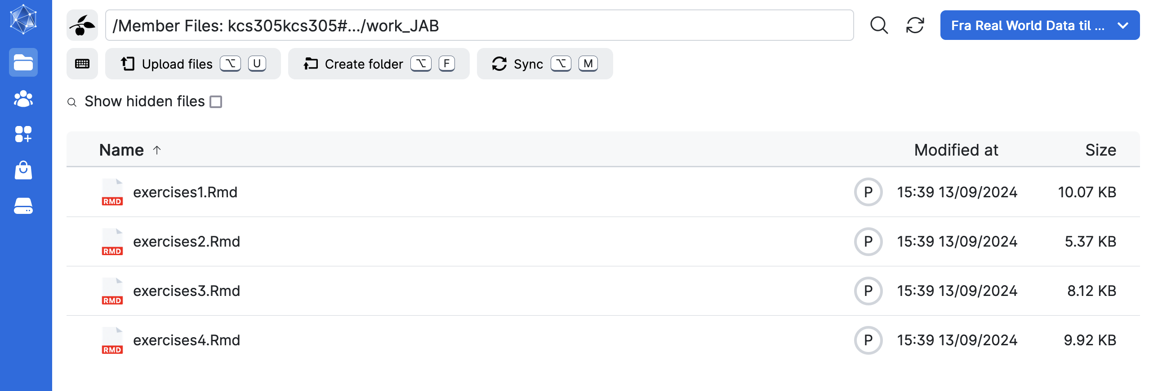
File management – working directory
Confirm that the copied files are where you think you sent them
We’ll refer to this as your working directory

Slide 25
File management – working directory
Note that we did not move the master ‘data’ folder into your working directory alongside the exercises – any clue why?

Slide 26
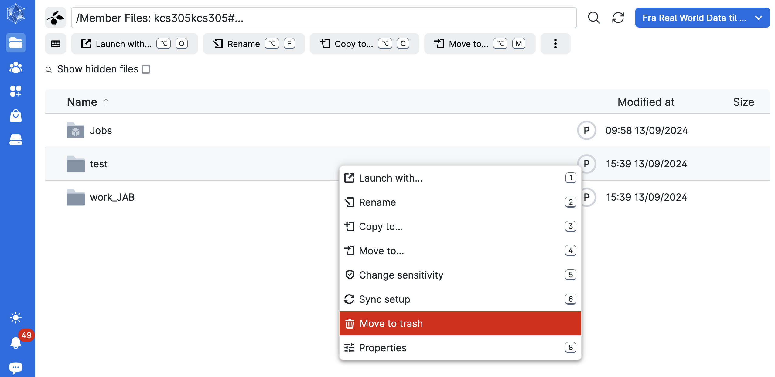
File management – deleting a file
1
Right click a file/folder in your drive if you want to remove it
2

Slide 27
File management – deleting a file
1
WARNING: trash is automatically emptied in X days
2

Slide 28
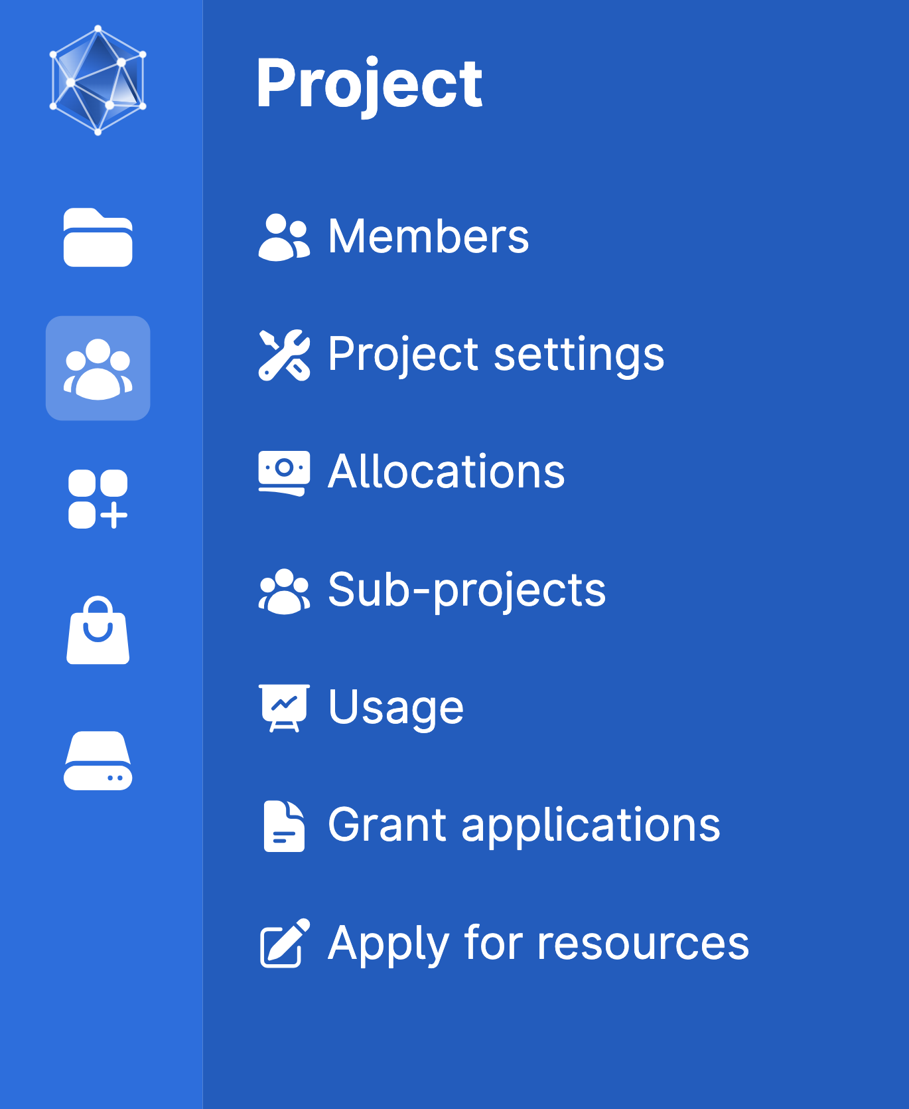
Projects on UCloud
Projects allow users to control permissions and resources for their workspace and associated files

Slide 29
Projects on UCloud
Projects allow users to control permissions and resources for their workspace and associated files
1
2

Slide 30
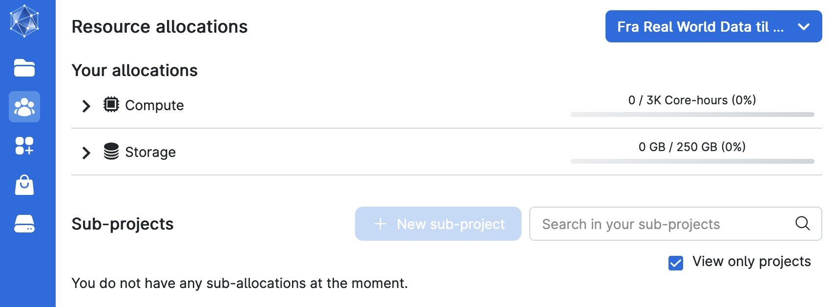
Tracking resource allocation

Slide 31
Tracking resource allocation
On HPCs, there are usually standard costs per core-hour of use and per GB of storage
We have this covered for you here, but practice safe HPC by being mindful of your usage

Slide 32
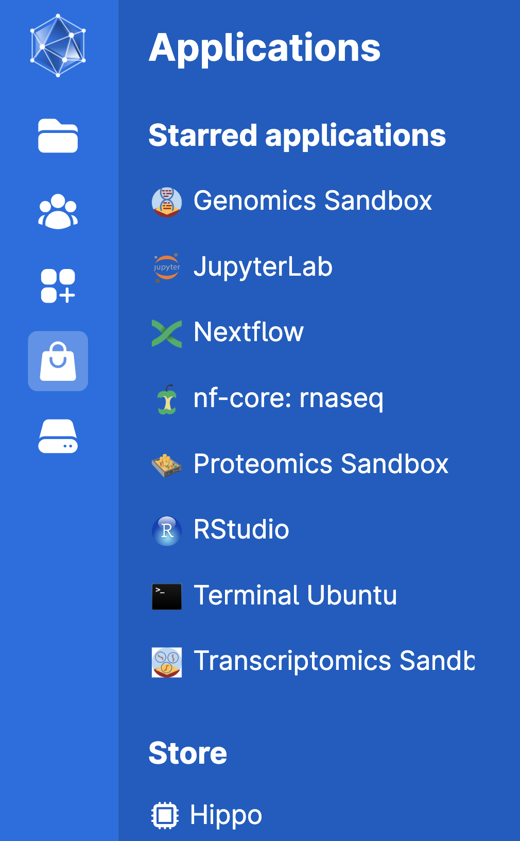
Accessing tools via UCloud Apps
Yes, there is a point to this intro, and we can actually use tools and custom environments to do computing on UCloud
You’ll need to go to the store and star RStudio in order to add it to your starred applications (for easy access)
1
2

Slide 33
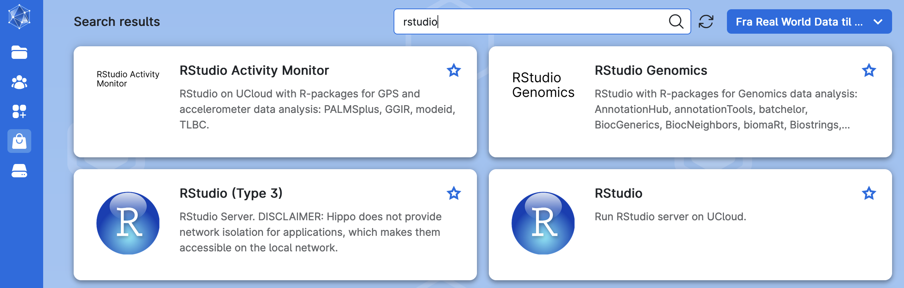
Submitting a job with the RStudio App

Slide 34
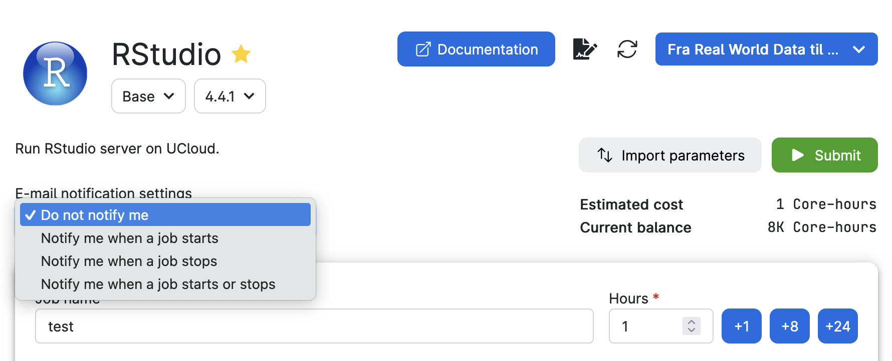
Submitting a job with the RStudio App – app info
Always check that you’re on the version of the app you want (usually the latest!)
Every app has a documentation link where you can find lots of info from the software maker

Slide 35
Submitting a job with the RStudio App – app info
Check the estimated ‘cost’ of the job, the balance, and the project that’s providing it

Slide 36
Submitting a job with the RStudio App – app info
We recommend no email notifications for beginners – this might be helpful if you’re running a multi-day job and want help monitoring its status

Slide 37
Submitting a job with the RStudio App – app info
You can import your prior job settings with import parameters

Slide 38
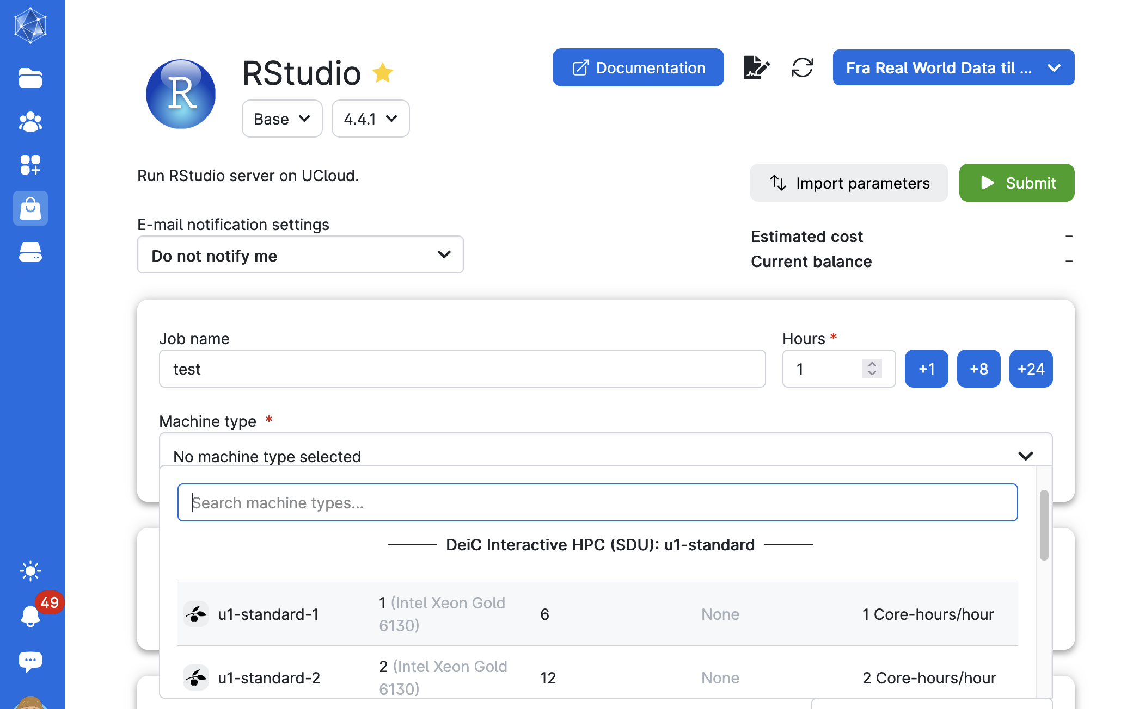
Submitting a job with the RStudio App - parameters
You should name your job – each job will output text files that give info on how the job ran that you may need to find later
Then you estimate how long you want the app to be active in hour increments (can be actively topped up)

Slide 39
Submitting a job with the RStudio App - parameters
We need to choose the type of computing machine we want to run our job on
we’ll use ‘u1-standard’ machines
We’ll only do testing with a 1 core machine (1 cpu) with 6 GB memory for our testing, but you might need multi-core machines for some jobs

Slide 40
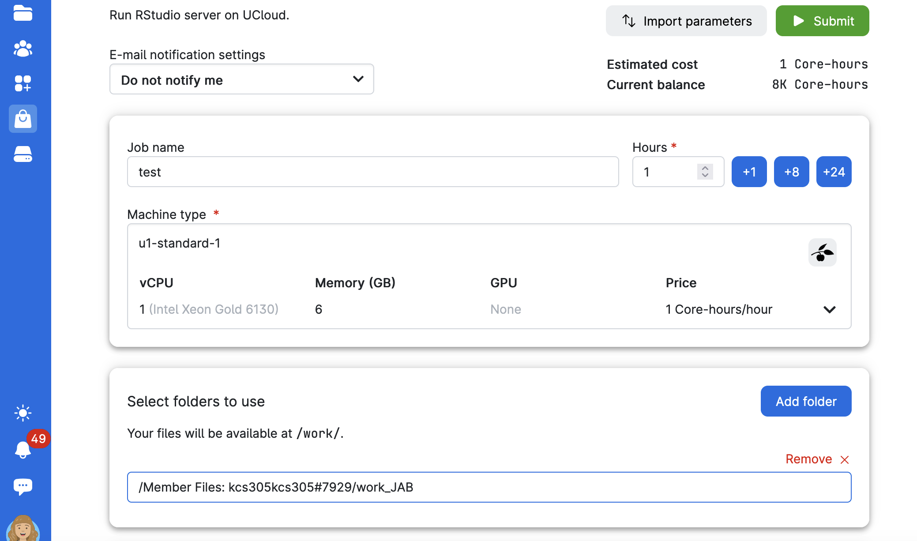
Submitting a job with the RStudio App
We need to add folders to access our personal saved files and any reference material (i.e. datasets)

Slide 41
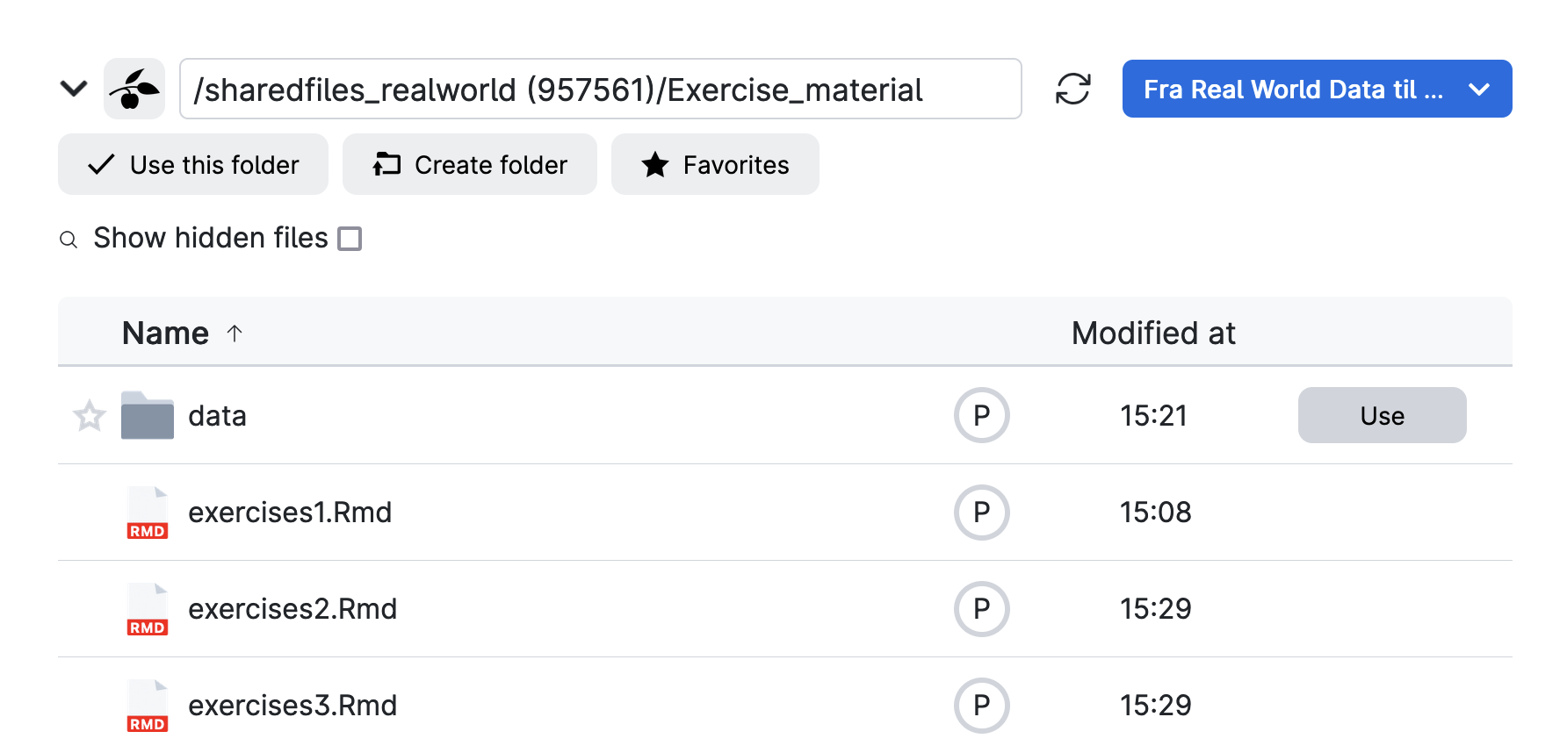
Submitting a job with the RStudio App

Slide 42
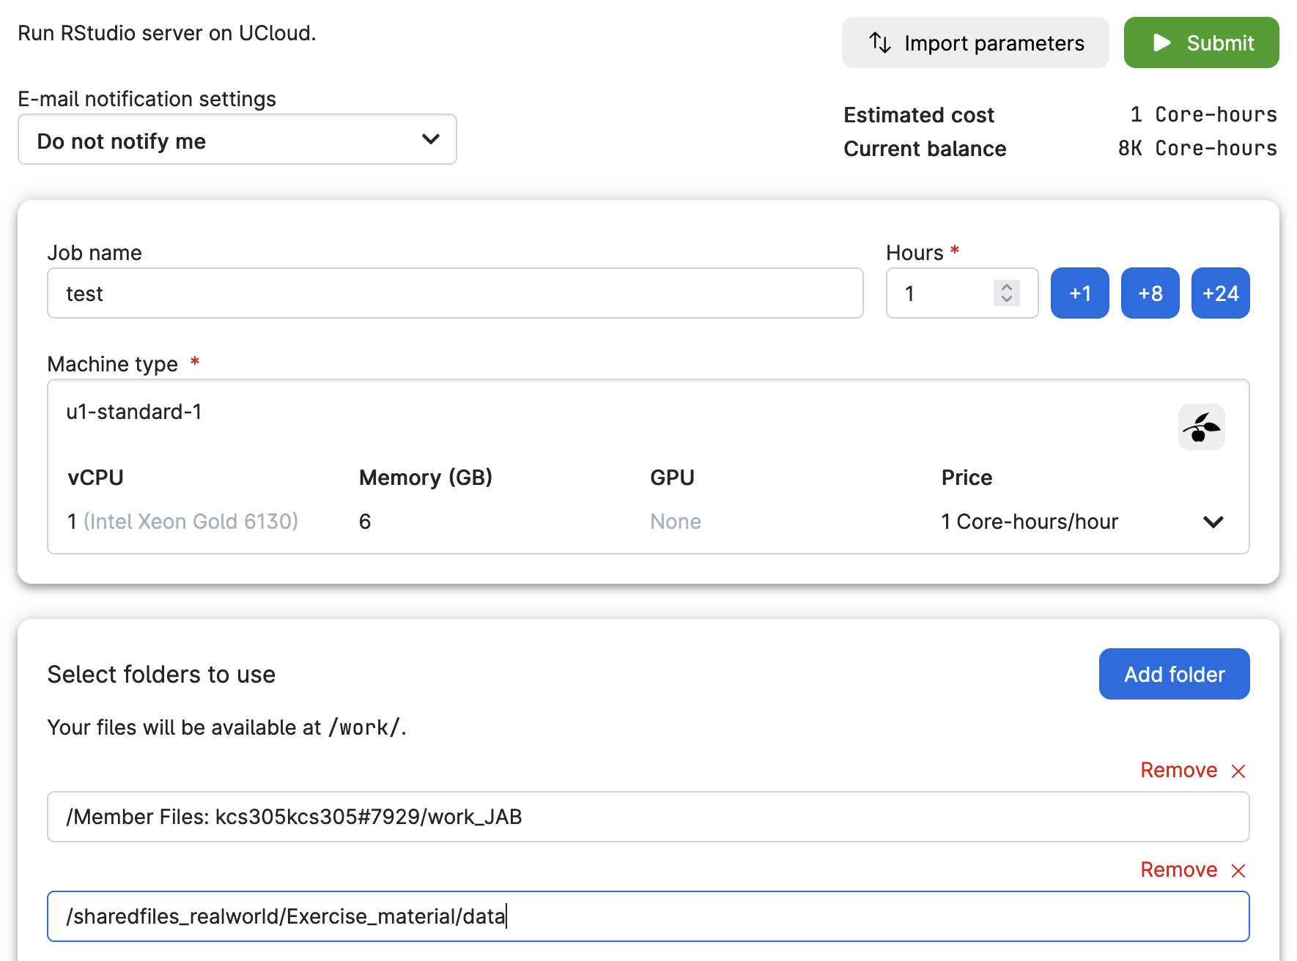
Final
setup
Check that all your parameter boxes ‘match’, and hit submit!

Slide 43
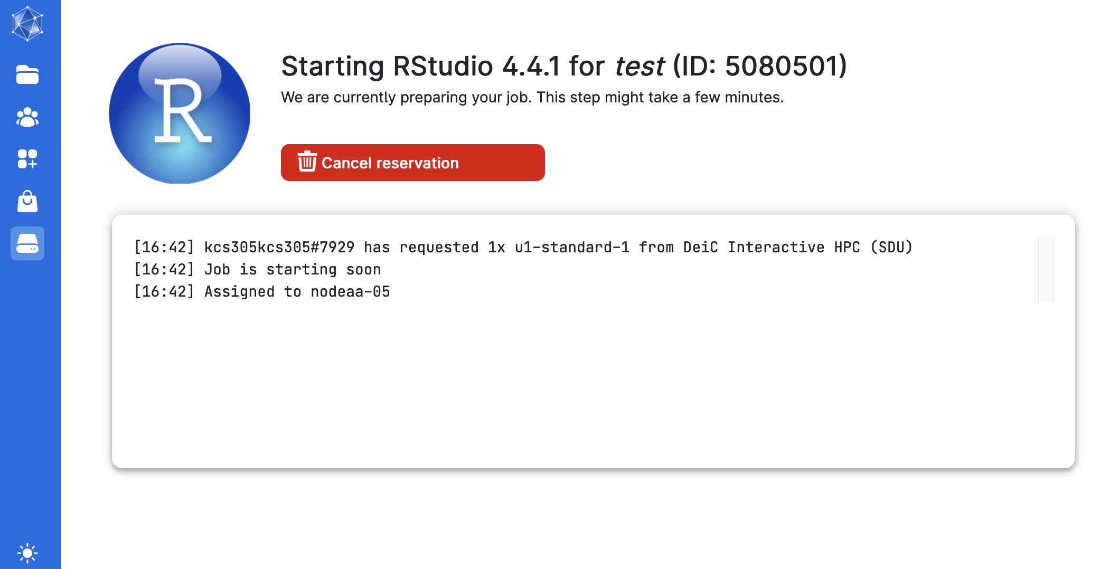
Submitting a job with the RStudio App
UCloud has many users, so it may take a while for the machine you requested to be available
Nearly impossible to get a GPU machine right now
If you ask for many cores, you’ll wait a while

Slide 44
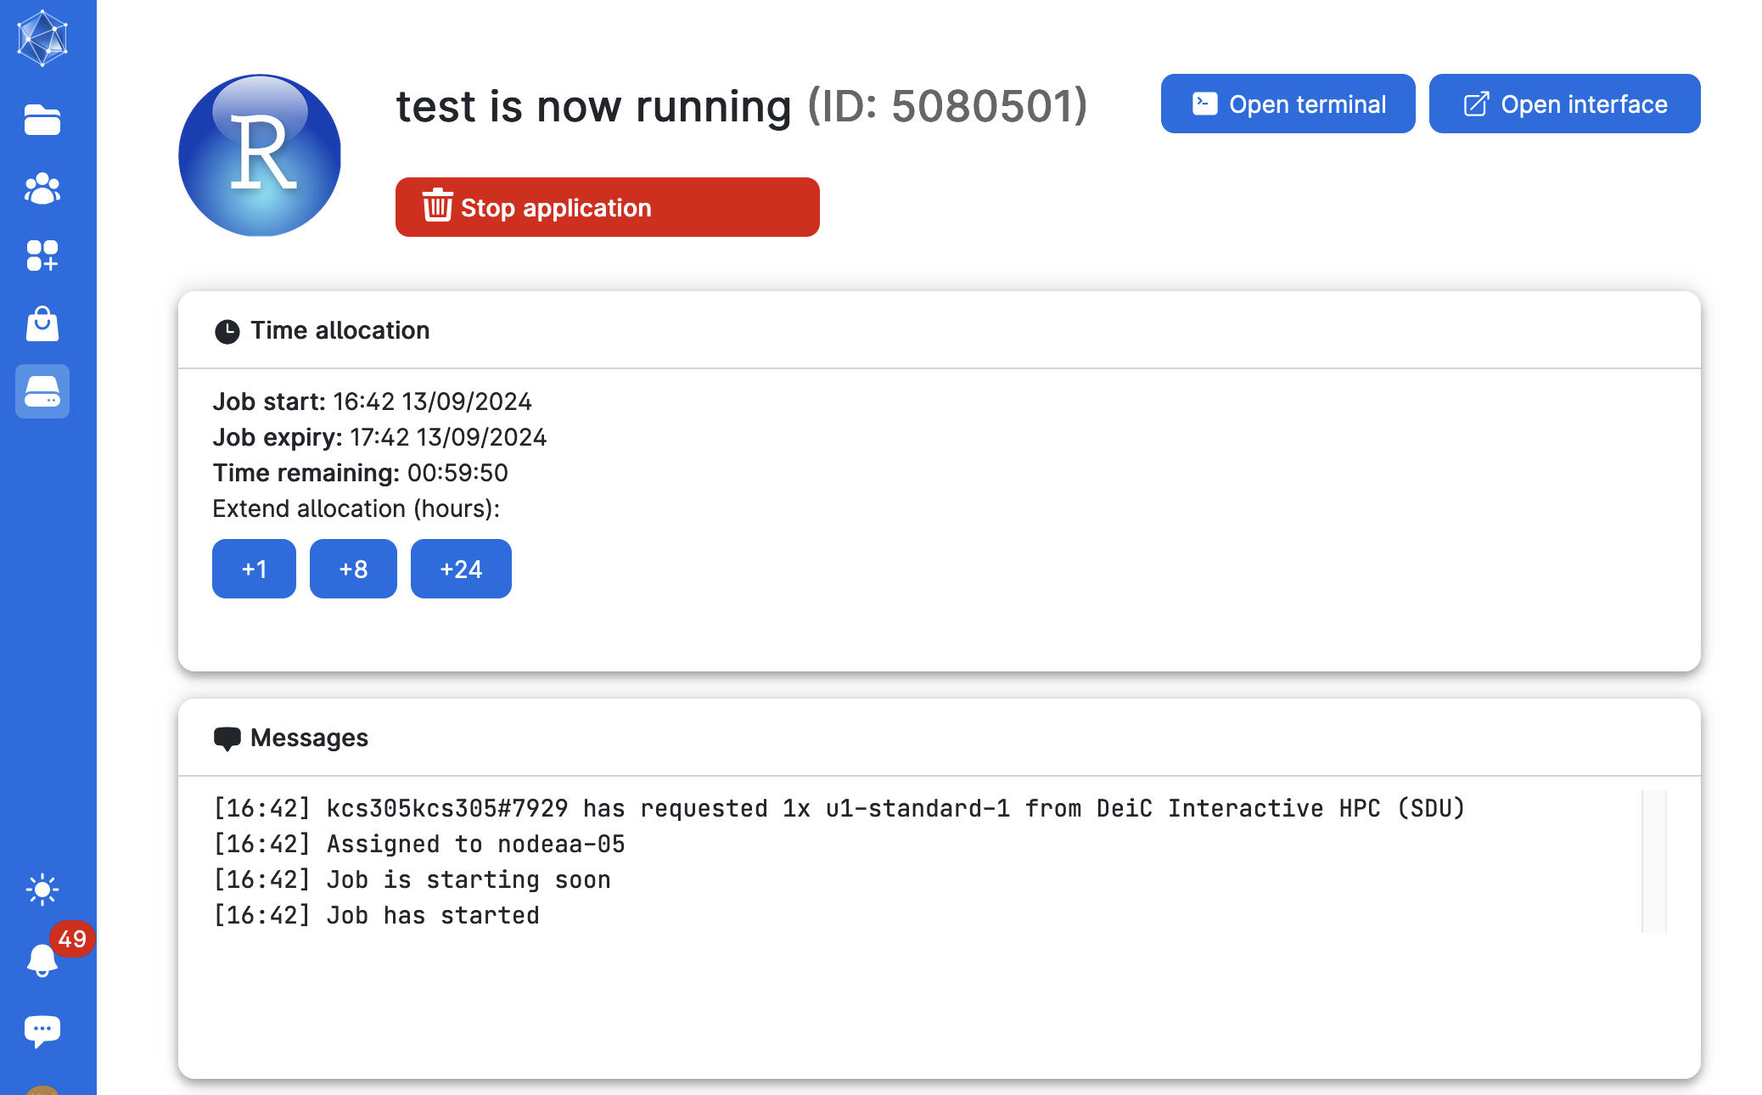
Submitting a job with the RStudio App
1
We got a machine!
You control your active job from this page
You can open the RStudio interface
You can actively see how much time you have left and top-up mid-job
You can stop the job (and stop using core-hours)
3
2

Slide 45
Caveats of using UCloud
You are creating an instance of a compute environment that is wiped after you shut it down
New package installs will disappear
All of your results and work will disappear (UNLESS YOU SAVE IT)
Your instance will die when your requested compute resources (core-hours) run out (unless you top up)

Slide 46
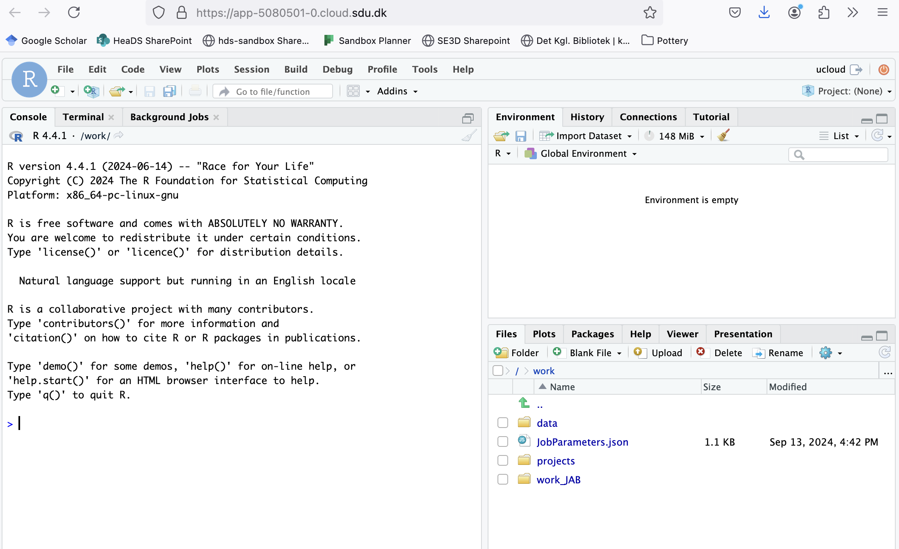

Slide 47
Lecture 1 – Explore using the RStudio app on UCloud

Slide 48
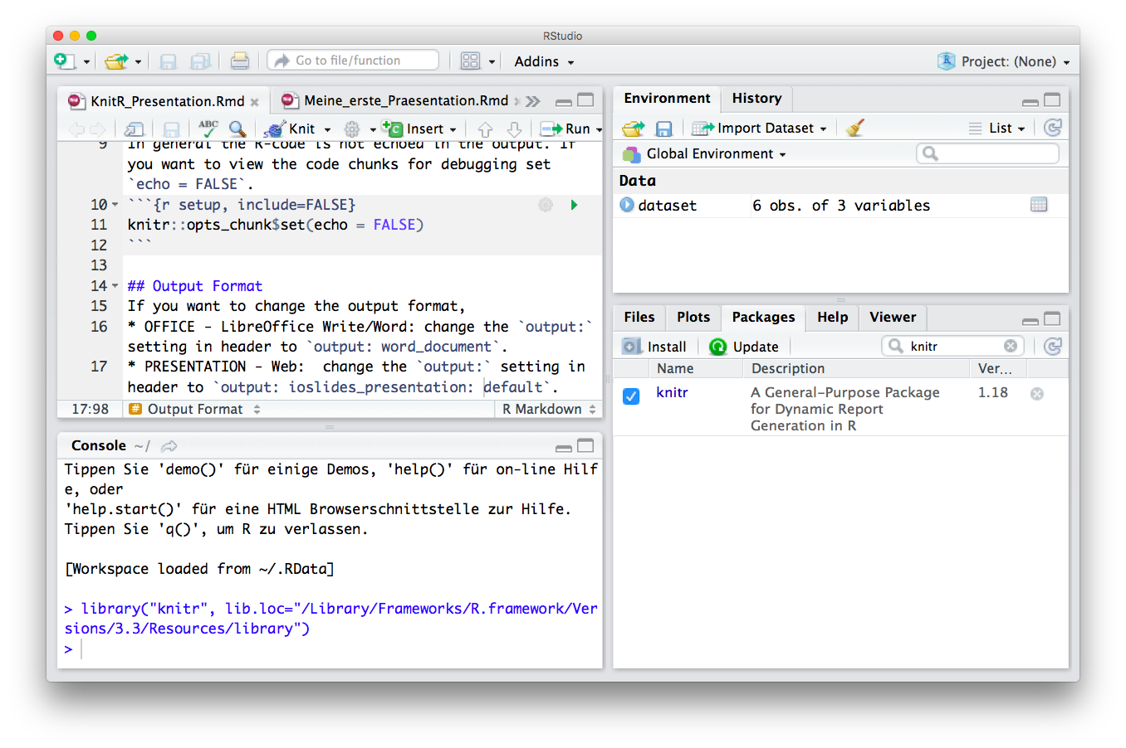


The R/RStudio ecosystem
R
R
Studio
Scripting / Programming Language
Objects in Environment
R-scripts (Save Your Code)
Console (Run and Test Code)
Overview by Type, Help and R-packages
Reports (html, pdf, latex)
R Code Interpreter and Editor
Notes:
Markdown is a plain text language with formatting syntax designed so that it can be converted to HTML and many other formats.
They are written using an extension of markdown syntax that enables R code to be embedded in them in a way which can later be executed.
Knitr takes a plain text document with embedded code, executes the code and 'knits' the results back into the document.

Slide 49
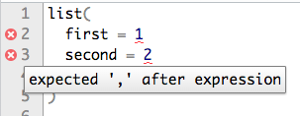
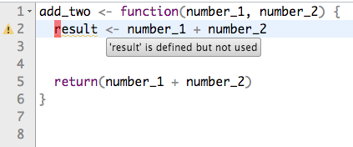

First time in R?
PACKAGES & FUNCTIONS
?my.package, ?my.function
What is it? Input?
install.packages(), remove.packages()
WORKING DIRECTORY
setwd(), getwd(), list.files(), list.dirs()
Were am I working from? Full/relative path.
?
SAVE YOUR WORK
.R, (or .Rmd)
The file with my code. Save it!
R project
Save Session, everything together
R
TIPS
Arrows to find the code you ran
R studio tips: view, diagnostics
Auto-complete with tab
R-cheat sheets (https://rstudio.com/resources/cheatsheets/)
RUN CODE
Run button, highlight enter, short-cut

Slide 50
1. R Project
File —> New Project —> New/Existing —> Create Project
Basic startup
2. Set Path
getwd() - Get directory
setwd() - Set directory
setwd(“/Users/Tom/Rstuff”) - Full path
setwd(“./Rstuff”) - Relative path
Session —> Set Working Directory —> Choose Directory
R
Studio
3. R Markdown
Script Icon —> R Markdown —> File —> Save as …
4. Install and load a R package.
install.packages(“my.package”)
library (my.package) - Load package.
Tools —> Install packages —> my.package
11

Slide 51
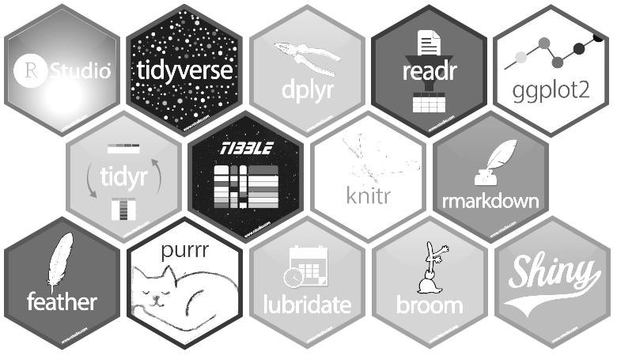
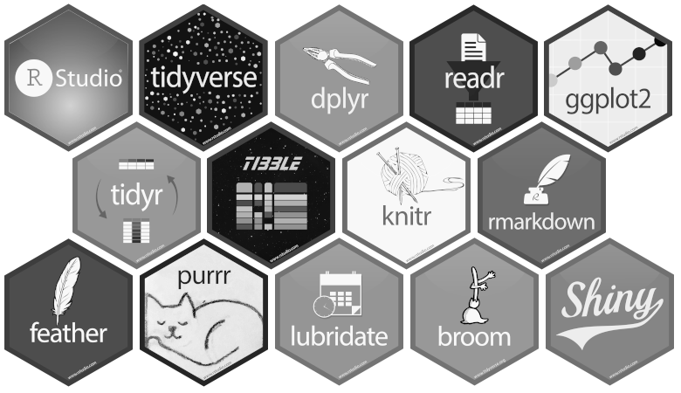
A markup language
Plain text format
Converted into HTML, PDF, LATEX
Finds code embedded in text
Evaluates the code
“Knits” the results into the document
R SCRIPT & RMARKDOWN
HOW TO
HOW TO
Write text as normal
Embed code ```{r} my.code```
Write code as normal
Comment text with #
.R SCRIPT
USE FOR
.Rmd SCRIPT
USE FOR
Testing new code
Big data analysis
Software development
Reports for yourself
Reports for collaborators
Tutorials
https://www.markdowntutorial.com/

Slide 52
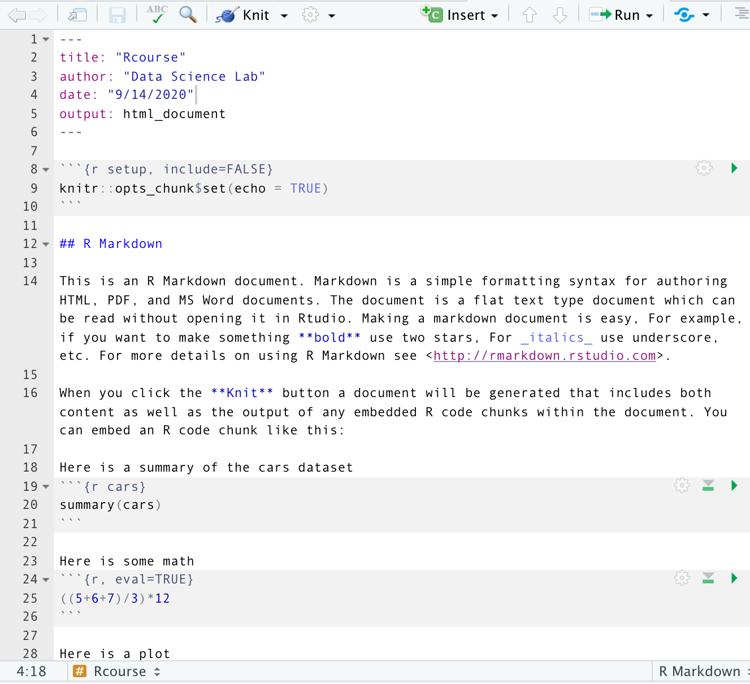
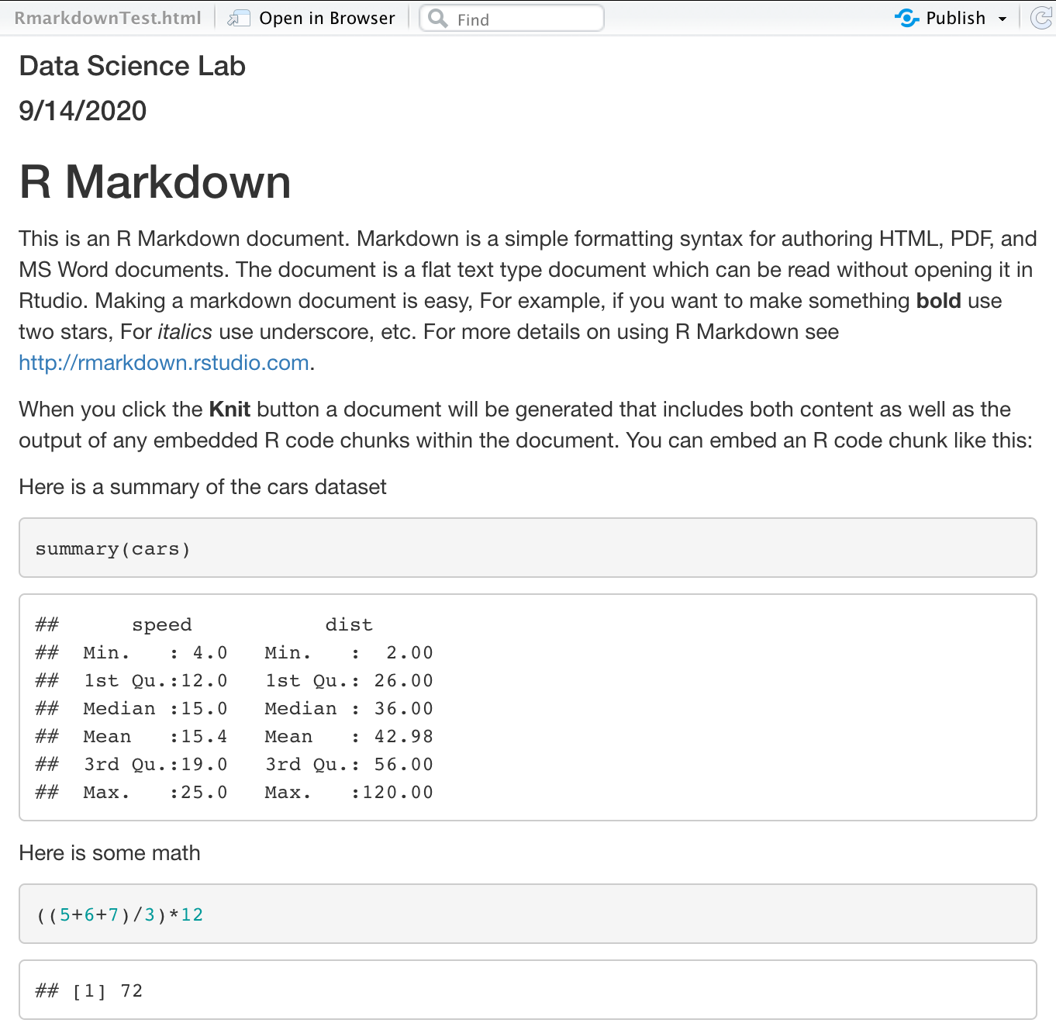
RMARKDOWN
REPRODUCIBLE ANALYSIS

Slide 53
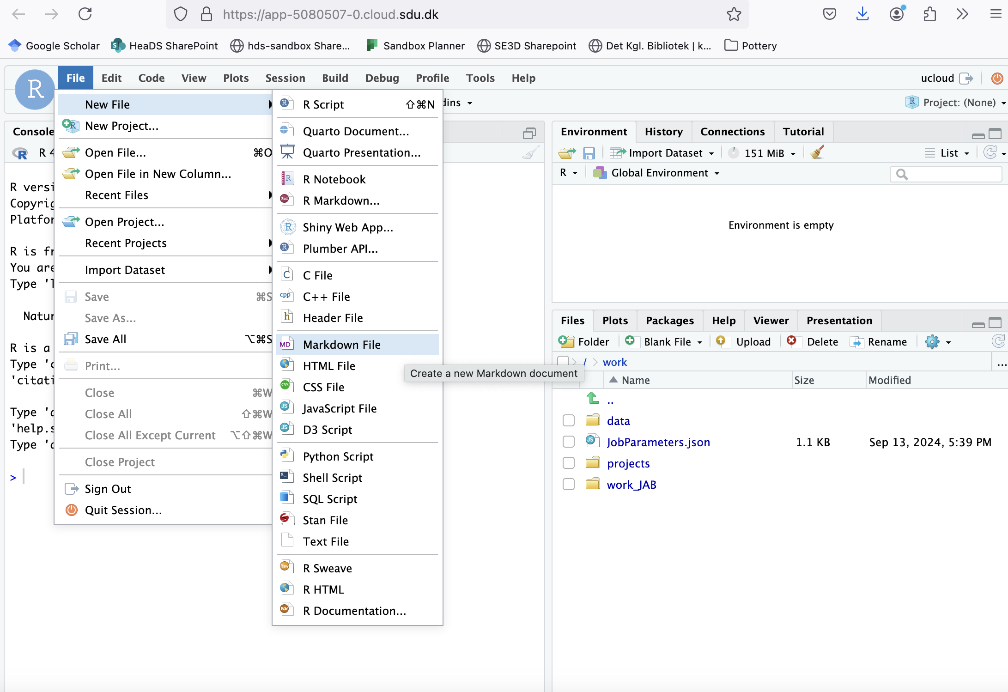
Practice making an Rmarkdown in your personal working folder

Slide 54
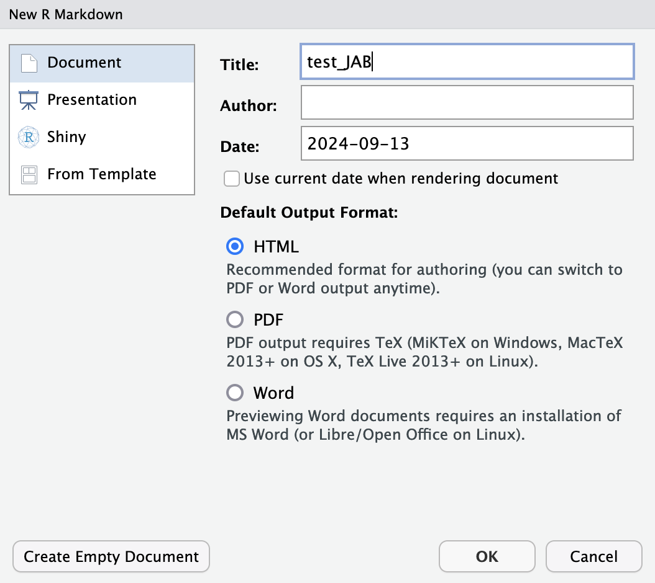
Practice making an Rmarkdown in your personal working folder

Slide 55
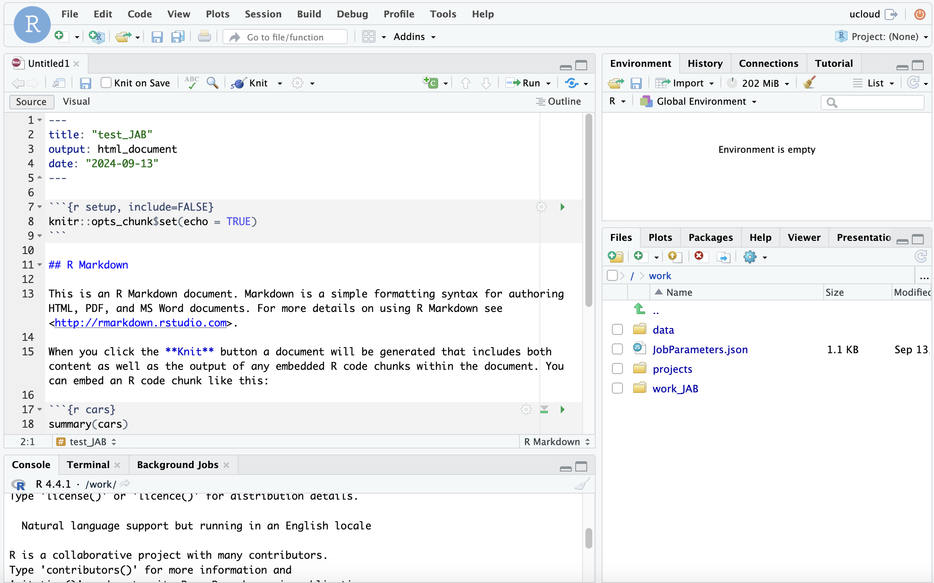
Practice making an Rmarkdown in your personal working folder

Slide 56
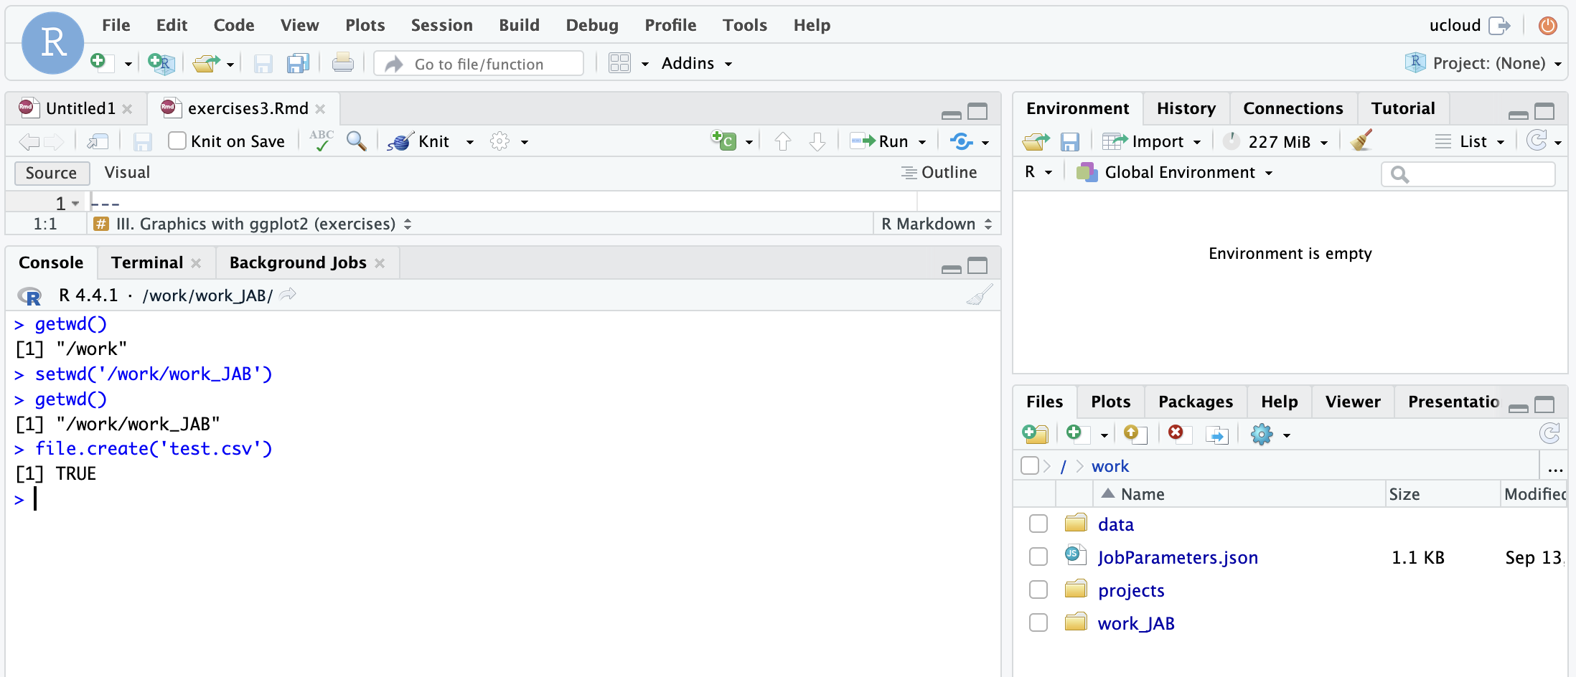
Practice setting your working directory

Slide 57
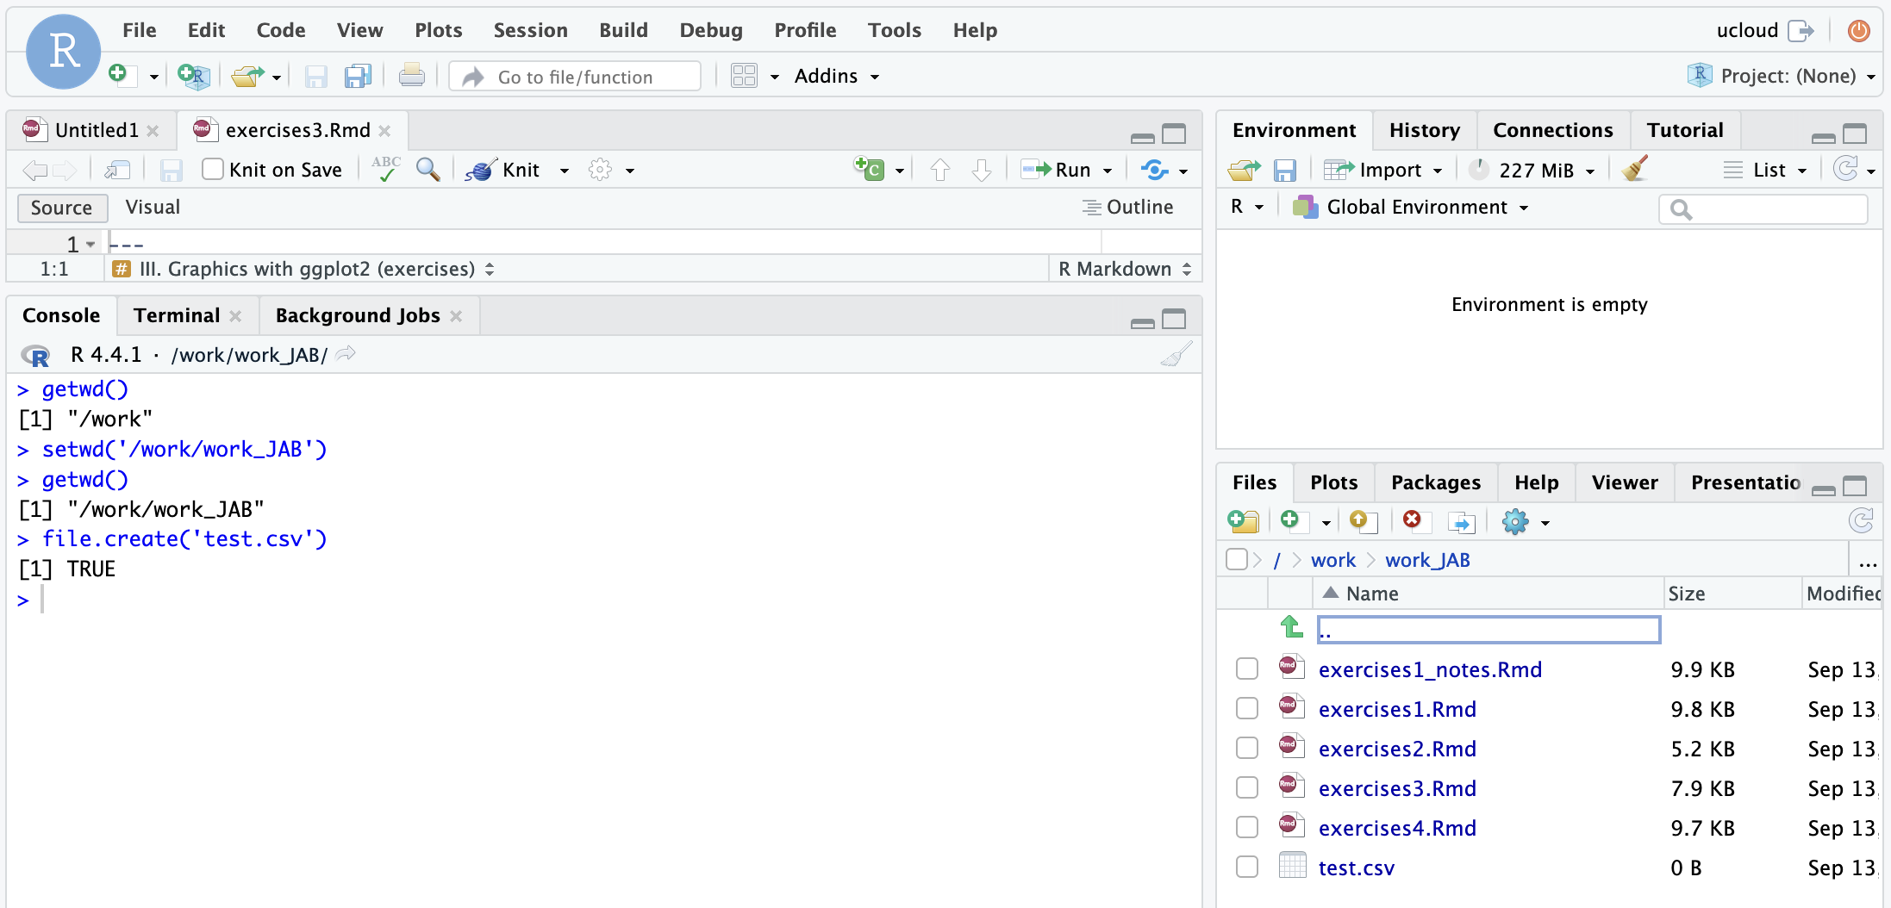
Practice setting your working directory

Slide 58
Structure of a function
function_name <- function(argument_1, argument_2) {
function body
return (output)
}
Functions are tools for performing the same task or computation in a consistent way
Your intermediate work is ‘hidden’ from the output window and environment
Many many functions are already available for you in base R, and new collections/libraries of functions for specific purposes are released as ‘packages’
You can write your own functions to streamline your analysis

Slide 59
Structure of a function
mean_two_numbers <- function(num_1, num_2) {
mean <- (num_1 + num_2) / 2
return (mean)
}
>>> mean_two_numbers(10,20)
[1] 15
>>> var_x <- mean_two_numbers(10,20)
>>> var_x
[1] 15

Slide 60
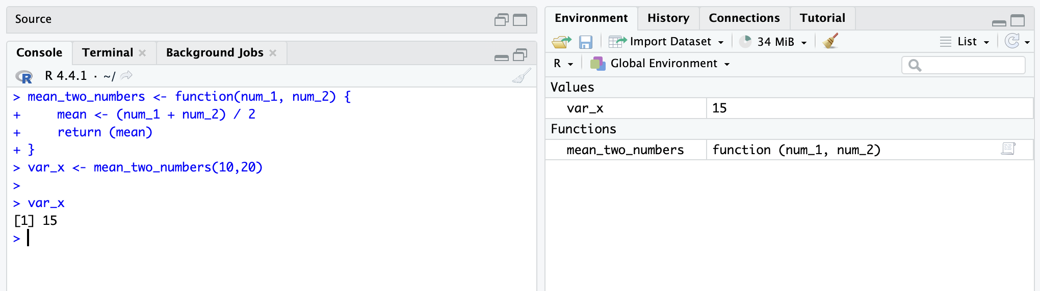
Structure of a function

Slide 61
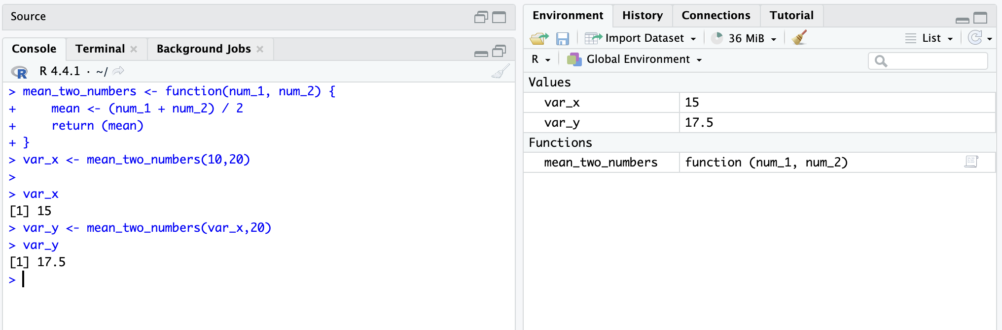
Structure of a function

Slide 62
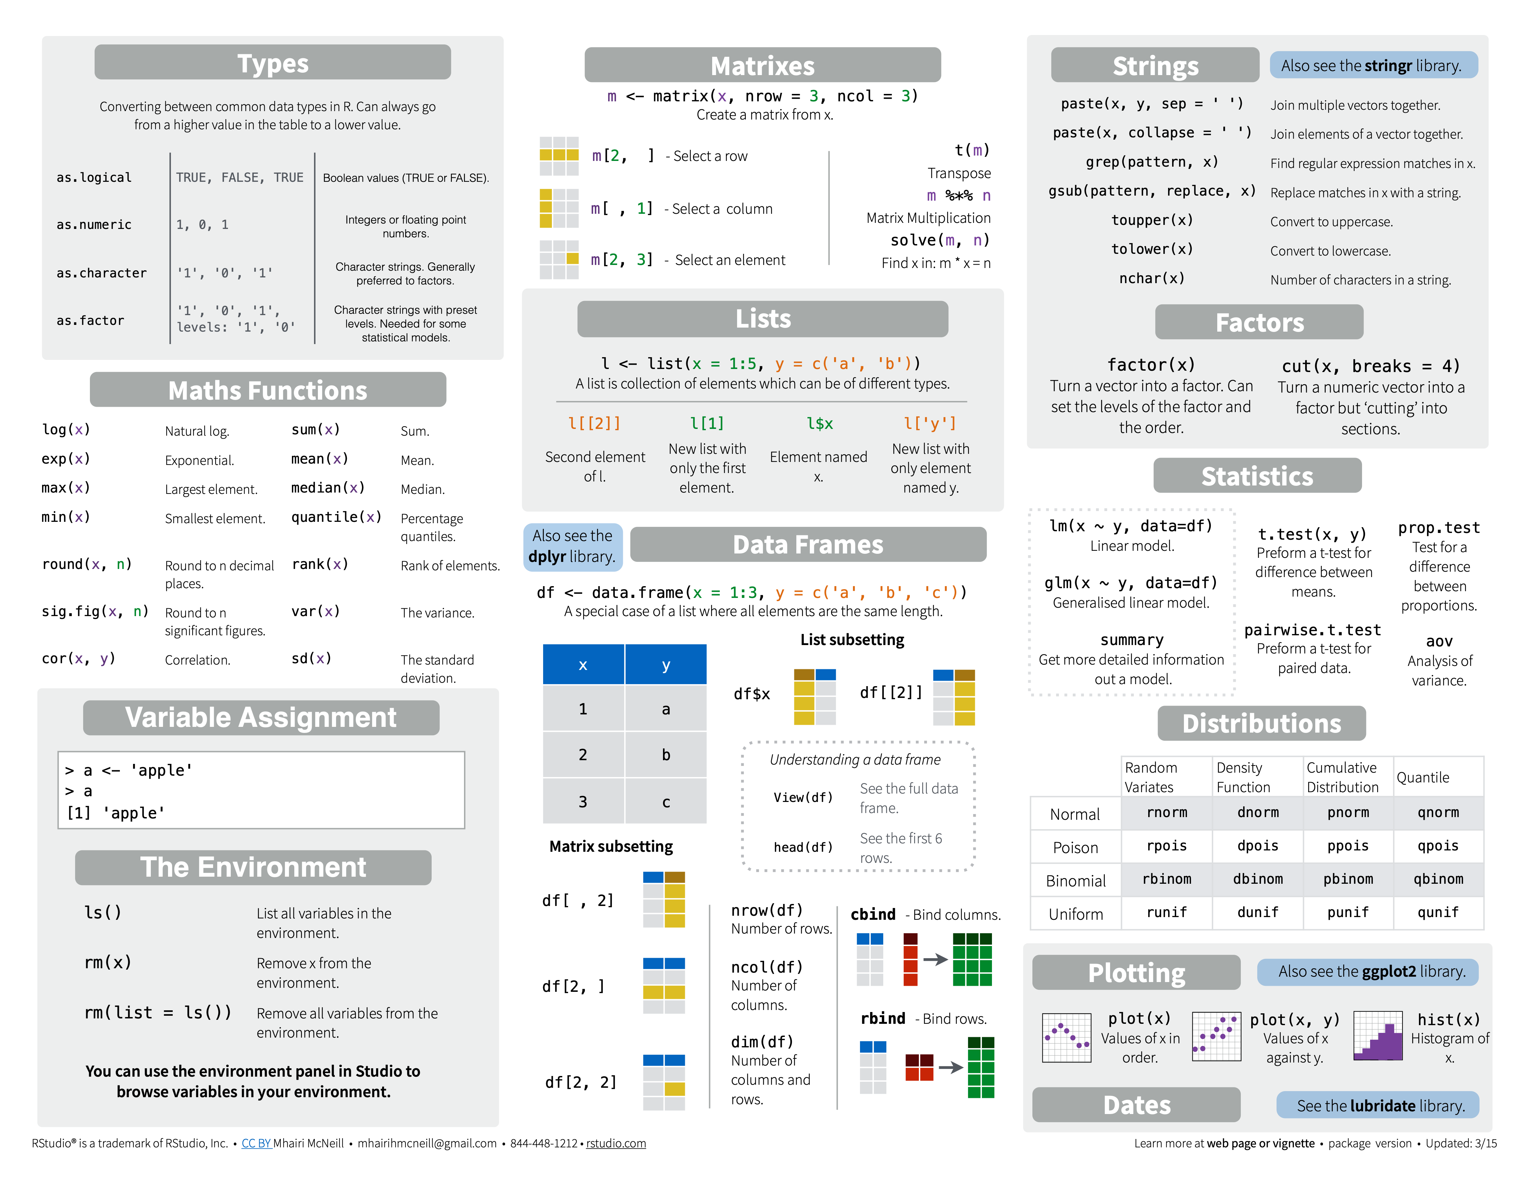
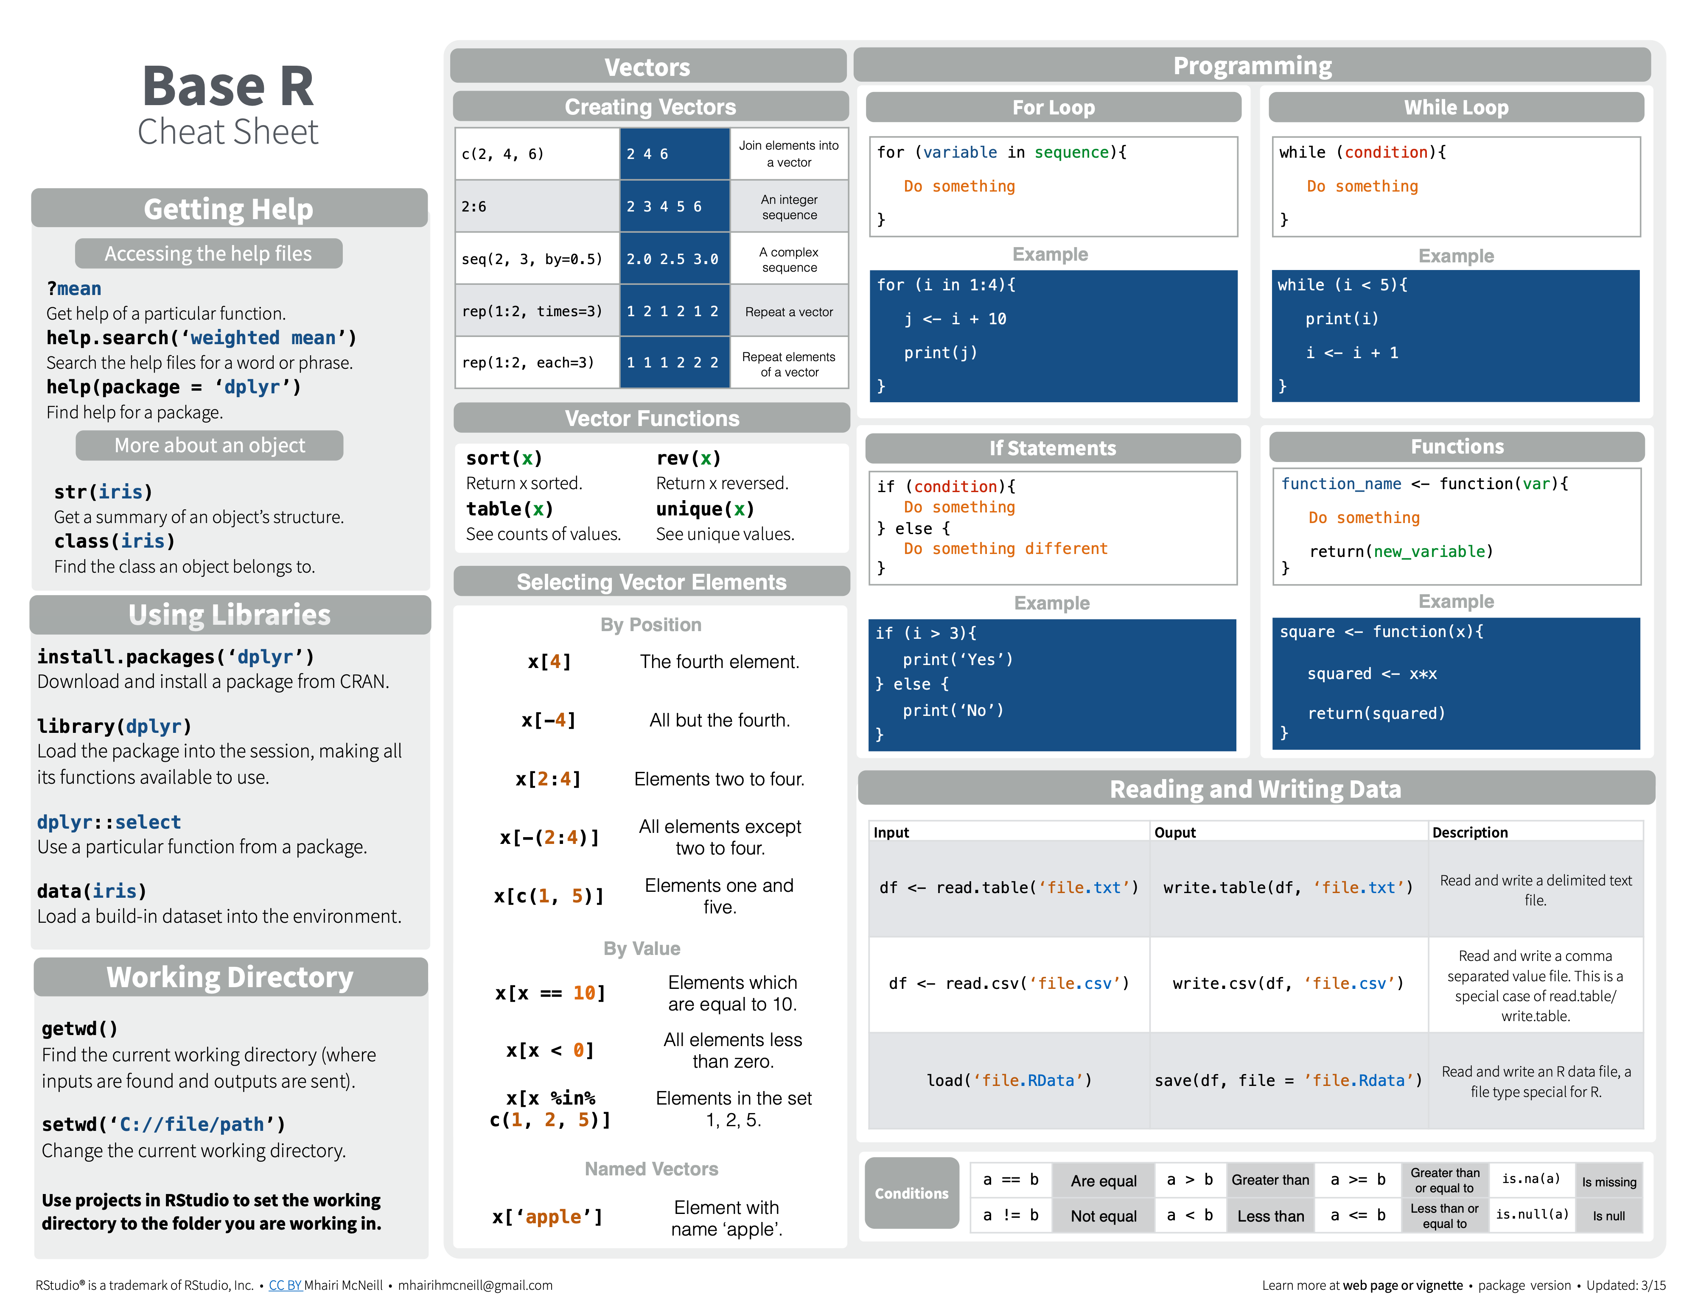
R Base syntax
VARIABLE ASSIGNMENT
> x <- c(1.5, 2.6, 1.7, 3.2, 3.0, 2.9, …)
> x
> [1] 1.5 2.6 1.7 3.2 3.0 2.9 …
READING AND WRITING DATA
DON’T USE
Spaces in names
Special characters
% ? / | \ & $ @
Unspecific names
Short/long names
DO
https://rstudio.com/resources/cheatsheets/
14

Slide 63
R Base syntax
SELECTING ELEMENTS
R-BASE FUNCTIONS
CONDITIONS
https://rstudio.com/resources/cheatsheets/

Slide 64
https://www.rstudio.com/wp-content/uploads/2016/10/r-cheat-sheet-3.pdf
BASE R CHEAT SHEET
Basics:
getwd(), setwd() # location
install.packages('pname'), library(pname)
ls(), rm() # list, remove objects
load(), data(), save() # load, save as .Rdata
Read in data:
read.xlsx('name.xlsx'), read.delim('name.txt', sep ='\t') read.csv('name.csv', sep=';')
GETTING STARTED
Overview:
head(df, n=10), df[1:10,] tail(df, n=10)
# first or last 10 rows
class() # data structure
unique(), table() # unique vals, count vals
Make Data:
c() # vector
data.frame(x=x,y=y)
matrix(x, nrow = 3, ncol = 3))
list(x=x, y=y)
DATA STRUCTURES & OVERVIEW
CHUNK OPTIONS
Is/As type:
Strings:
paste(x, y, sep = '')
grep('pattern', x) # find str pattern
gsub('pattern', 'replace', x) # replace with
DATA TYPES & STRINGS
is.numeric(x) (character, factor, integer, etc.)
as.numeric(x) (factor, matrix, data.frame, etc.)
Other:
Plots:
VECTORS &
BASE PLOTS
seq(1, 10, by = 1.0) # sequence from-to
rep(x, times) # replicate n times
sort(), reverse() # sort or reverse vector
plot(x)
plot(x,y) # scatter
hist(x) # histogram

Slide 65

Getting
help
02
01
HOW TO
NOT FREAK OUT
WHEN LEARNING R
GETTING HELP
?
Ask us and ask your peers (in Slack!)
Look at the R presentations we go through.
Use the cheat sheets in this presentation and online: https://rstudio.com/resources/cheatsheets/
Remember, you are NOT suppose to remember commands by heart! No programmer does this.
Learning a programming language is like learning a real language - it takes practice, mistakes, …
Google it! Most important skill of all.
You will get the solutions to the exercises near the end of the day.
2

Slide 66
Exercise 1 – Explore using the RStudio app on UCloud

Slide 67
1
2
R project & R Script
Read & Write
Basic calculus
Base plot
R help
Save & Shutdown
EXERCISE 1
R
Studio
3
4
5
17

Slide 68
Lecture 2 – Explore using tidyverse for data wrangling

Slide 69
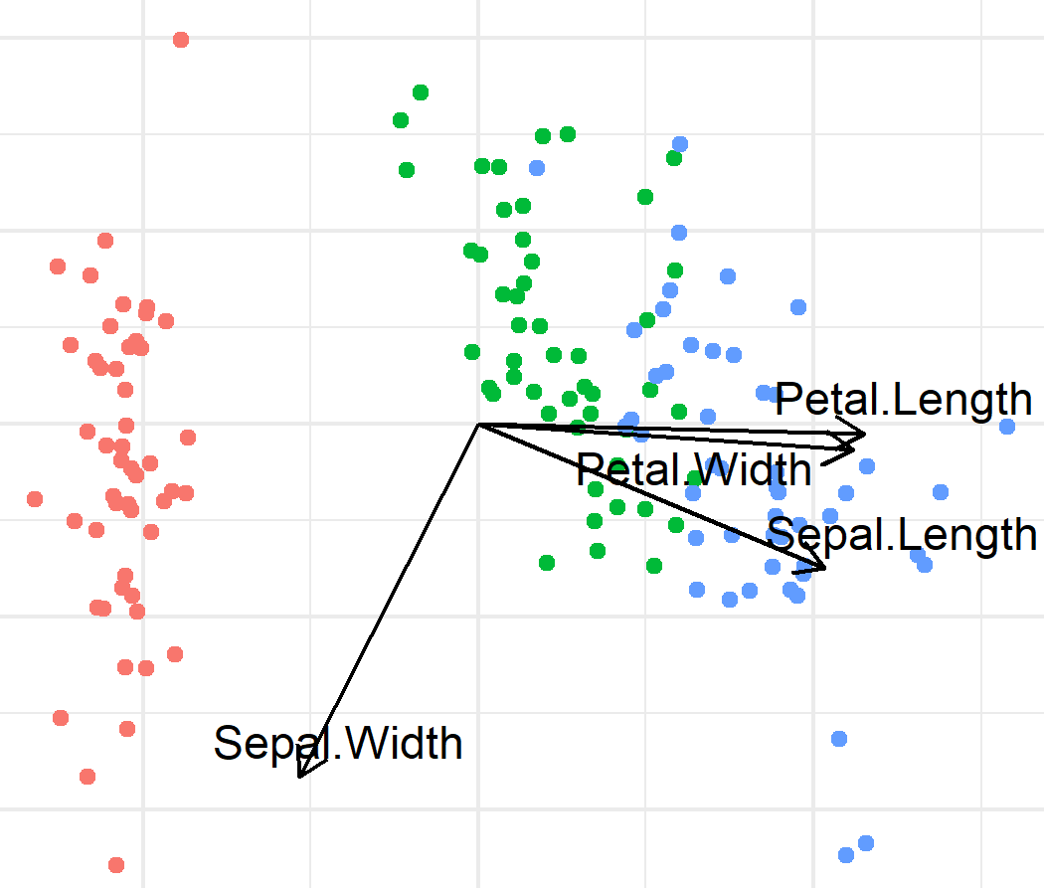
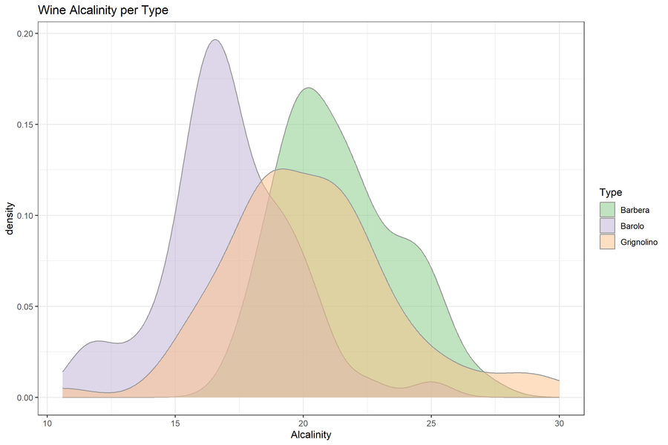
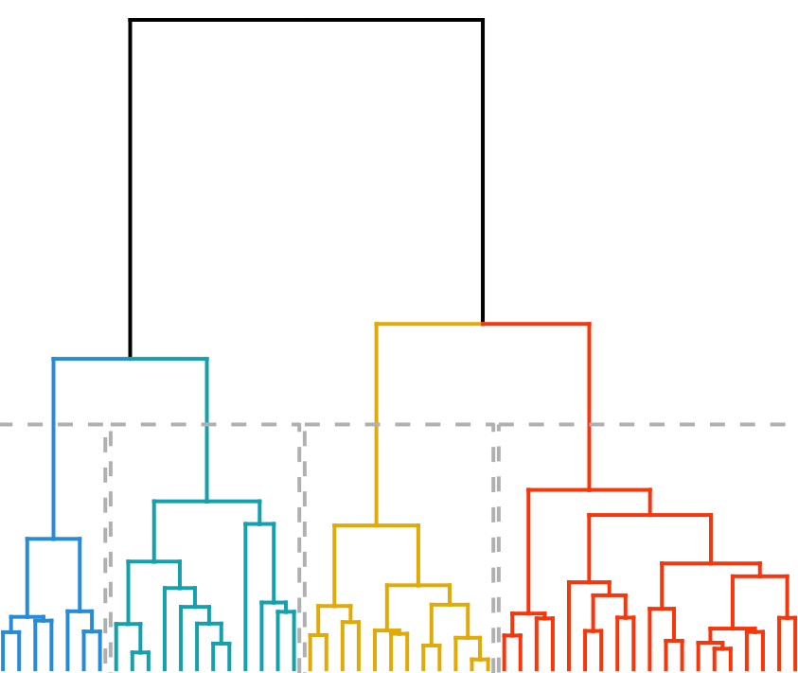
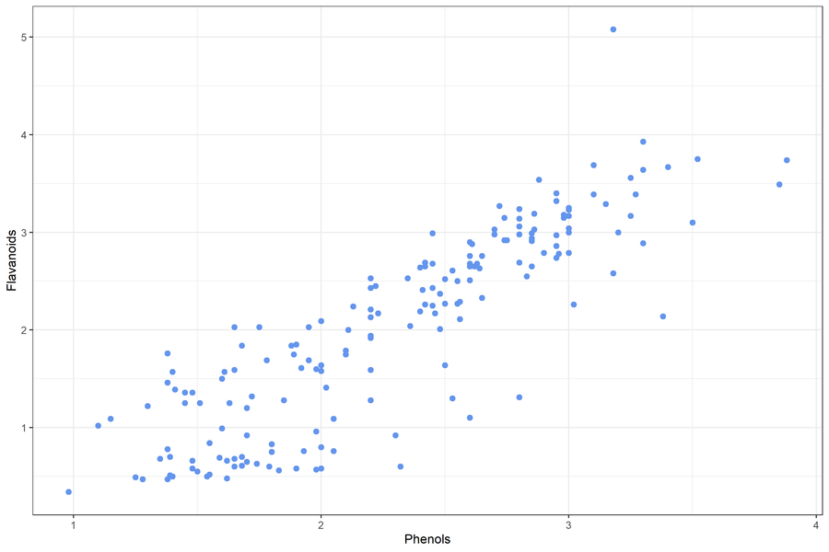
EXPLORATORY
DATA ANALYSIS
Biplot
Density Plot
Before we start an analysis we need to familiarize ourselves with the data
What data do we have?
Does it look as you expected?
Is it suitable for the planned analysis?
How do we need to prepare the data for analysis?
Dendrogram
Scatter Plot
Notes:
Need to check both your own data and data you find somewhere else (repositories,ect)
It’s important to find good data
Examples of ‘bad’ stuff:
Linear regression on 3 data points
T-test on 5 data points
Confirm that data is suitable for planned analysis
Or
Help with idea generation(patterns, relationships between variables)
Establish whether:
Data looks as expected
identify obvious errors: outliers, label swaps
Something needs to be corrected
Preparation method
(normalization is needed?)
Are there patterns between variables?
What is the relationship between variables
How do we need to prepare the data for analysis?
What kind of analysis can we do?
https://www.ibm.com/topics/exploratory-data-analysis
Originally developed by American mathematician John Tukey in the 1970s, EDA techniques continue to be a widely used method in the data discovery process today.

Slide 70

DATA CLEANING AND SET-UP
Wide w. missing values
We want to clean up our data:
Remove data outliers or duplicates
Ensure categorical variables are spelled the same
Change one type of variable to another type
Merge, add or remove variables
Layout, long VS wide format
Treatment | Age | height | weight
A | 55.0 | NA | 65.7
B | 31.0 | 172.0 | 69.4
C | 39.0 | 161.0 | NA
Imputation
Treatment | Age | height | weight
A | 55.0 | 170.0 | 65.7
B | 31.0 | 172.0 | 69.4
C | 39.0 | 161.0 | 58.1
Wide to long
Treatment | variable | value
A | Age | 55.0
A | height | 170.0
A | weight | 65.7
B | Age | 31.0
B | height | 172.0
B | weight | 69.4
C | Age | 39.0
C | height | 161.0
C | weight | 58.1
Missing values:
Filter out some/all missing values
Impute missing values (Regression, Maximum Likelihood, ML)
Notes:
Types of variables: factors, binary, characters, numerical, integers

Slide 71
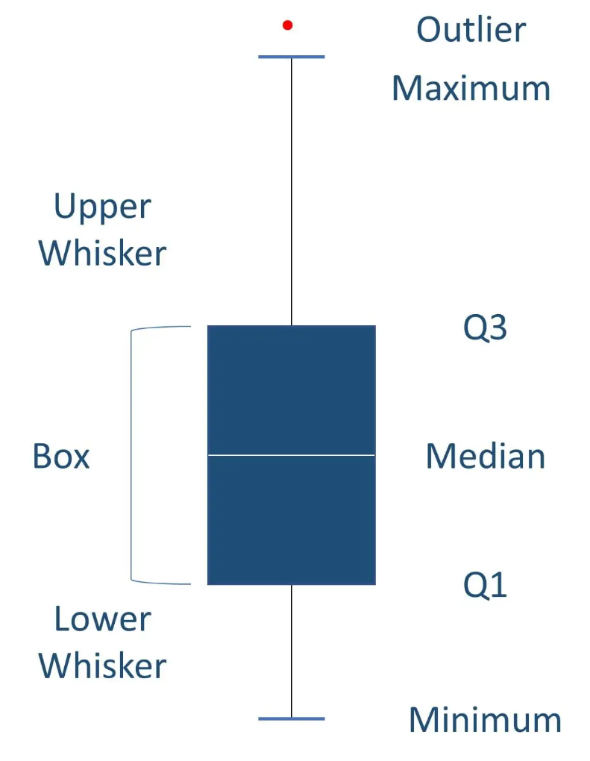
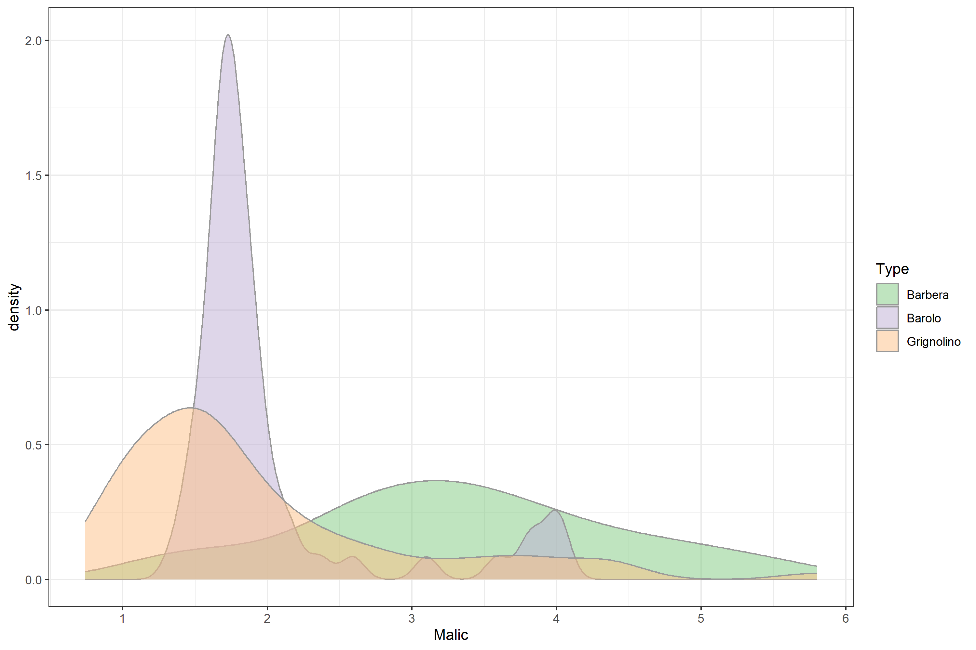
SUMMARY STATISTICS
Summary statistics are used to distill a dataset into some key characteristics.
They often include the following measures:
Central tendency (mean, median, mode)
Spread (standard deviation)
Minimum and Maximum
Quartiles
Shape of the distribution
Correlation between features
Notes:
Scales
Some features more predictive than others
Technical variables to be removed/included
Missing values

Slide 72
DATA STRUCTURES
DATA TYPES
Vector
Numeric
Age
-1.5, 2.7, 3.2
Data Frame
Age
Height
BMI
Integer
R DATA TYPES & STRUCTURES
-2, -1, 0, 3, 5
List
Character
“A”, “Bat”, “Tom”
VARIABLES
Array
Factor
OBSERVATIONS
G1, G1, G2, G3
Tibble
Logical
< >
< >
< >
< >
< >
TRUE, FALSE
Notes:
A double is a double-precision, 64-bit floating-point data type. It accommodates 15 to 16 digits, with a range of approximately 5.0 × 10−345 to 1.7 × 10308

Slide 73
Why does data structure matter?
You will most often work with vectors and dataframes
Sometimes other structures are a more flexible or faster solution for a specific job, but we leave that to future you to figure out
If you are struggling to use a function with a particular data structure, check whether the function has hard requirements on input format
The key thing is to check which structure your data is imported as
- Use str to check type and scope of both your data structure and types

Slide 74
Why does data type matter?
Distinguishing between numeric, character, and categorical is your most common task
Numbers can be assigned to a character or categorical (factor) data type (sometimes this is useful)
the number 2, the character 2, and the category 2 are all different things, and will not equal each other in R
Dates are hell… good luck (hot tip – google the R package ‘lubridate’)
The key thing is to check which data type each of the variables in your dataset is imported as (and correct errors)
- Use str to check type and scope of both your data structure and types

Slide 75







tidyverse is a collection of R packages for data science
READING DATA
“The packages share an underlying design philosophy, grammar, and data structures.” Wickham and Grolemund
TIDYING
TIDYVERSE
MANIPULATION
tidyverse is used to “tidy up” your datasets, so they are easy to work with
PROGRAMMING
VISUALIZATION
18
https://www.tidyverse.org/

Slide 76
Using tidyverse pipes
You do NOT have to “choose” between
tidyverse and base R
Examples of pipes using tidyverse
base R
# think from the inside out
g(f(x,y),z)
tidyverse
tidyverse
base R
# no brain acrobatics
x %>% f(y) %>% g(z)
pipe symbol
https://www.tidyverse.org/
Notes:
dpyr functions are like lego. You can add them however you want (in theory).

Slide 77
TIDYVERSE CHEAT SHEET
readr, tidyr, dplyr, …
Read Data (readr)
Data Tidying (tidyr)
Data Manipulation (dplyr)
Reading tabular data
There are solutions for multiple data types
read_excel() # using readxl package
read_table()
read_csv()
Useful arguments
Skip lines: read_csv(file, skip=1)
Read subset: read_csv(file, n_max=1)
Data types
readr guesses the types of each column and tells you about it
(“Parsed with column specifications: …”)
Handle missing values
drop_na()
fill()
replace_na()
Subsetting
tibble[:,1:5] # returns a tibble
tibble$colname # returns a vector
(same as tibble[[colname]])
Reorganize layout
Change between long and wide format
gather() # wide to long
spread() # long to wide
Summary
summarise()/summarize()
count()
Group
group_by()
Functions will manipulate each group separately and combine results.
Extract and sort observations # i.e. rows
filter() # subset by condition
distinct() # subset to unique values
top_n() # subset by position
arrange() # sort low->high, other way with desc()
Manipulate variables # i.e. columns
select()
mutate(new_name = f(column))
Vectorised functions
Ranking: percent_rank()
Math: Any arithmetic or logical operations, between(), near()
if_else()
HELP
R Documentation (e.g. enter ?dplyr::filter and see examples)
Much more info and detailed cheat sheets:
https://brianward1428.medium.com/introduction-to-tidyverse-7b3dbf2337d5
It also helps to google “tidyverse + whatever_you_want_to_do”
20

Slide 78
Practice loading a file from the shared folder

Slide 79

Practice loading a file from the shared folder

Slide 80
Exercise 2 – Explore using tidyverse for data wrangling

Slide 81
1
2
TIDYVERSE
R
Studio
3
EXERCISE 2
4
Tidyverse:
Filtering
Selecting
Mutating
Arranging
Summarizing
5
21

Slide 82
Practice saving, shutting down, and restarting your work

Slide 83
Lecture 3 – Explore how to use ggplot to explore and visualize your data

Slide 84





GGPLOT2 - EASY GRAPHICS
https://www.r-graph-gallery.com/
Aesthetically pleasing graphics.
Well-defined “additive” (+) structure.
Integrates perfectly with tidy data.
Great documentation & community
27

Slide 85




DATASET, SAMPLES & OBSERVATIONS
ggplot(my.DS, aes(x=Sample, y=Measure))
GGPLOT2
ADDITIVE STRUCTURE
ggplot(my.DS, aes(x=Sample, y=Measure))
+ geom_boxplot()
DEFINE PLOT TYPE
ggplot(my.DS, aes(x=Sample, y=Measure, fill=Sample))
+ geom_boxplot()
COLOR BY GROUP
… + ggtitle("Basic boxplot") + theme(legend.position=“none”, plot.title = element_text(size=11))
TITLE AND LEGEND
… + scale_fill_manual(values = c("lightgray", "steelblue",
“aquamarine3", "seagreen4"))
CUSTOM COLORS
http://tutorials.iq.harvard.edu/R/Rgraphics/Rgraphics.html
BACKGROUND
+ theme_minimal()
Notes:
Aesthetic mappings describe how variables in the data are mapped to visual properties (aesthetics) of geoms.

Slide 86



GGPLOT BASIC STRUCTURE
Alternatively, you can specify additional parameters directly in the geom:
Geoms inherit the parameters from the ggplot they are added to:
Things outside the aes are applied to everything!
ggplot(my_wine,
aes(x=Type, y=Alc, fill=Country))
geom_col()
ggplot(my_wine,
aes(x=Type, y=Alc))
geom_col(aes(fill=Country))
ggplot(my_wine,
aes(x=Type, y=Alc))
geom_col(fill='green')
29

Slide 87

Examples of plot types from ggplot
Notes:
https://ouyanglab.com/covid19dataviz/ggplot2.html

Slide 88

More examples 😅
Notes:
https://ouyanglab.com/covid19dataviz/ggplot2.html

Slide 89
GGPLOT CHEAT SHEET
Define Plot:
Add Plot Type:
GET STARTED
+ geom_point()
+ geom_line()
+ geom_boxplot()
+ geom_col()
+ geom_density()
+ geom_histogram()
ggplot(data = my.data, aes(x = x.var, y = y.var))
One Color:
Color Fill by Group:
Custom Colors:
ggplot(…, aes(…, color = “green”))
ggplot(…, aes(…, fill = group.var))
scale_*_manual(values = c())
ex: scale_color_manual(values = c(“blue”, “pink”))
COLORS
More Colors:
Grid Theme:
theme_bw()
theme_minimal()
theme_dark()
theme_*()
COLOR SCALES & THEMES
scale_fill_grey(start = 0.2, end = 0.8)
scale_fill_gradient(low="white", high=“red”)
Labels:
Text:
ggtitle(“…”)
xlab(“…”)
ylab(“…”)
theme(* = element_text())
theme(axis.title = element_text(angle = 90, colour= “red”), legend.text = element_text(size = 8, face = “bold”))
TEXT
https://rstudio.com/wp-content/uploads/2016/11/ggplot2-cheatsheet-2.1.pdf
29

Slide 90



R - A STATISTICAL
SCRIPTING LANGUAGE
Y
MODEL FUNCTIONS
EMMEANS PACKAGE
lm(), glm()
lmer(), glmer(),
nls(), …
emmeans(), pairs(), cld()
X
Variable 1
Variable 2
A
B
APPLY TO MODEL
MORE FUNCTIONS
summary(), anova(), confint(), predict(), drop1(), update(), step(), …
t.test(), cor(), cor.test(), aov(), quantile(), p.adjust(),
rank(), …
C
D
31
http://www.sthda.com/english/

Slide 91
STATS CHEAT SHEET
Import Data:
Overview of Data:
summary(my.data)
nrow(my.data)
length(my.data)
names(my.data)
GET STARTED
read_excel(“my.data.xlsx”)
Linear:
Logistic:
Linear Mixed:
Check Model:
summary(model) par(mfrow=c(2,2))
plot(model)
REGRESSION MODELS
lm(y~x, data=my.data)
confint(model)
glm(y~x,
data=my.data)
lmer(y~x + (1|z), data=my.data)
ANOVA:
F-Test:
Emmeans:
TESTS/
COMPARISONS
emmeans(model,~x)
pairs(emmeans(model,~x))
anova(model2, model1)
drop1(model, test="F")
Check Type:
Change Type:
table(my.data$x)
is.numeric(my.data$x)
is.factor(my.data$x)
my.data <- mutate(my.data, x = factor(x))
my.data$z <- as.numeric(my.data$z)
VARIABLES
https://rstudio.com/resources/cheatsheets/ for various relevant cheat sheets.
Other example: https://www.dummies.com/programming/r/statistical-analysis-with-r-for-dummies-cheat-sheet/
34

Slide 92
Exercise 3 – Explore how to use ggplot to explore and visualize your data

Slide 93
Exercise 4 – Try out some functions for building simple models (linear regression)

Slide 94
Lecture 4 – Inspo for data science & wrap-up

Slide 95
Recap: we’re almost done… how does everybody feel?
Notes:
https://ouyanglab.com/covid19dataviz/ggplot2.html

Slide 96





But why R?
Formal programming languages have distinct advantages in analyzing data instead of tools like Excel
/
Quick overview
Processing power
Easy starting
Data Wrangling
Reproducibility
Raw data exposed
Complex analyses
Manual analysis
Programming language

Slide 97

FROM EXCEL TO R
Max: 1000000 rows and 16000 cols
Upper limit of an object in R is 2^31
Limited to some operations
Super flexible, almost everything
Some Stats, mostly math
Stats/bioinf., etc. different fields
Okay for the basics
R
Highly customised plots
Cells are mutable - ‘bad’
Markdown, Git, shiny, etc.
Great for small/medium data
Big Dataset
Especially great for big data
Data Wrangling
Data Analysis
Plotting
Reproducibility
Quick Overview
5

Slide 98

This is everything we covered today – feel accomplished!
DATA WRANGLING
PLOTTING
tidyverse
Data Structures
Useful Functions
Pipe (“clean” code)
ggplot2
Code structure
ggplot2 + tidy data
THE BASICS
REPRODUCIBILITY
R
R base syntax
RStudio
Scripts, paths, files
R project
Help recourses
R Markdown
Doc. types
Good practices
Other cool things
APPLIED STATISTICS IN R

Slide 99
DATA TYPES IN HDS
Measurements
i.e. height, weight, heart rate
Represented as a number or a category
Often low dimensional, but wearables are changing that
Survey Data
Can be descriptive, numeric or categorical
Relies on reporting, i.e. very prone to bias
MEASUREMENT
SURVEY
DATA
Omics Data
i.e. genomics, proteomics
(Ultra) high-dimensional
Needs a lot of preprocessing
OMICS
DATA
Descriptive Data
i.e. patient journals, registry data
Highly person-sensitive
Not easily standardized
DESCRIPTIVE
DATA

Slide 100
WHICH APROACH SHOULD WE USE?
STATISTICAL ANALYSIS
MACHINE LEARNING
’Simple’ question
Linear relationships
Small dataset (few obs.)
High dimensional data
Non-linear relationships
SUPERVISED
UNSUPERVISED
The scientific questions asked are central to the methods chosen.
The dataset size guides choice of algorithm.
Outcome is known
Outcome is unknown
Fully data driven
Notes:
Technical variation that affect different samples differently
This can obscure difference or create differences that are not real
We want to remove this variation as much as possible since we are interested in biological variation
There is of course background noise in our data, this can sometimes modelled and sometimes it is so little and random we do not expect it to affect our analysis, in that case we simply ignore it.

Slide 101

Calibrating expectations for data analysis
https://imgs.xkcd.com/comics/flawed_data.png
Notes:
https://www.explainxkcd.com/wiki/index.php/2341:_Scientist_Tech_Help
https://m.xkcd.com/2582/

Slide 102

Data analysis: a discussion of terms
You have likely heard the words
Data Science (DS), Machine Learning (ML) and Artificial Intelligence (AI)
These are often used as synonyms, but they do not mean the same thing
What do they mean? Let’s discuss!
https://imgs.xkcd.com/comics/data_trap.png
Notes:
https://www.explainxkcd.com/wiki/index.php/2341:_Scientist_Tech_Help
https://m.xkcd.com/2582/

Slide 103
Data analysis: a discussion of terms
DATA SCIENCE != MACHINE LEARNING
Machine learning - development of algorithms that enable computers to learn from data and make predictions or decisions (with human-like performance or better)
Data Science (DS) - a variety of techniques for extracting knowledge from data - involves cleaning, normalizing, and analyzing large data to uncover patterns and trends
https://imgs.xkcd.com/comics/data_trap.png
Notes:
https://www.explainxkcd.com/wiki/index.php/2341:_Scientist_Tech_Help
https://m.xkcd.com/2582/

Slide 104

Data analysis: a discussion of terms
Artificial Intelligence:
The ability of computing systems to achieve human-like performance on complex tasks
Conceptual umbrella term
AI is the outcome, not the method
https://imgs.xkcd.com/comics/ai_methodology.png

Slide 105

Data analysis: a discussion of terms
Machine Learning:
"Technologies and algorithms that enable systems to identify patterns, make decisions, and improve themselves through experience and data" [1]
Machine learning is methodology
Currently our most successful way of achieving AI
https://imgs.xkcd.com/comics/machine_learning.png

Slide 106

Data analysis: a discussion of terms
https://imgs.xkcd.com/comics/drone_training.png
Deep Learning:
When you do ML by means of a deep neural network
This is a type of/sub-class of ML using a more complex architecture of a specific ML tool (neural network), which is one of the many varieties of ML tools
ChatGPT and other major large language models were created with this technique
Notes:
https://www.ibm.com/think/topics/ai-vs-machine-learning-vs-deep-learning-vs-neural-networks

Slide 107
FROM EXCEL TO R
ONLINE RESOURCES FOR R
https://www.r-project.org/
GET STARTED
GRAPHICS
BOOKS & COURSES
OTHER RESOURCES
https://www.r-bloggers.com/best-books-to-learn-r-programming/
https://www.datacamp.com/
https://www.codecademy.com/
https://www.coursera.org/
https://github.com/trending/r
https://blog.revolutionanalytics.com/
https://stackoverflow.com/questions/tagged/r
https://rseek.org/
https://rstudio.com/resources/cheatsheets/
http://www.cookbook-r.com/
https://www.statmethods.net/r-tutorial/index.html
https://www.r-graph-gallery.com/
http://r-statistics.co/Top50-Ggplot2-Visualizations-MasterList-R-Code.html
12

Slide 108



FROM EXCEL TO R
WANT MO-R-E?
The Section for Biostatistics offers a number statistics-oriented R courses:
https://publichealth.ku.dk/about-the-department/biostat/
* These are screenshots. Go to the website and scroll down to ‘Teaching’
38

Slide 109




Survival Analysis
survival: https://rviews.rstudio.com/2017/09/25/survival-analysis-with-r/
survminer: https://cran.r-project.org/web/packages/survminer/survminer.pdf
(https://rpkgs.datanovia.com/survminer/ )
Mixed-Effects Models
lme4: https://cran.r-project.org/web/packages/lme4/vignettes/lmer.pdf
https://cran.microsoft.com/snapshot/2017-08-01/web/packages/sjPlot/vignettes/sjplmer.html
glmmTMB: https://cran.r-project.org/web/packages/glmmTMB/index.html
TEASER
STATISTICS in R
Epidemiological Analysis
Epi: https://cran.r-project.org/web/packages/Epi/index.html
pubh: https://rviews.rstudio.com/2020/03/05/covid-19-epidemiology-with-r/
https://cran.r-project.org/web/packages/incidence/vignettes/customize_plot.html
https://rviews.rstudio.com/2020/03/05/covid-19-epidemiology-with-r/
Elastic-Net Regression (R
glmnet: https://cran.r-project.org/web/packages/glmnet/glmnet.pdf
elasticnet: https://cran.r-project.org/web/packages/elasticnet/elasticnet.pdf
https://www.datacamp.com/community/tutorials/tutorial-ridge-lasso-elastic-net
21
39

Slide 110



Clustering
Feature Selection: PCA
Missing Data
TEASER
Machine Learning
https://lgatto.github.io/IntroMachineLearningWithR/an-introduction-to-machine-learning-with-r.html
https://statsandr.com/blog/clustering-analysis-k-means-and-hierarchical-clustering-by-hand-and-in-r/
https://bioconductor.org/packages/release/bioc/vignettes/PCAtools/inst/doc/PCAtools.html
https://amices.org/mice/
https://datascienceplus.com/imputing-missing-data-with-r-mice-package/
Random Forest
kNN
SVM
Neural Networks
https://www.blopig.com/blog/2017/04/a-very-basic-introduction-to-random-forests-using-r/
https://www.edureka.co/blog/knn-algorithm-in-r/
https://cran.r-project.org/web/packages/e1071/vignettes/svmdoc.pdf
https://keras.rstudio.com/
https://tensorflow.rstudio.com/
40

Slide 111









GWAS - QC &
Data Harmonization
GWAS Data Management & Plots
More Plotting…
EasyQC: https://www.uni-regensburg.de/medizin/epidemiologie-praeventivmedizin/genetische-epidemiologie/software/
EasyStrata: https://www.uni-regensburg.de/medizin/epidemiologie-praeventivmedizin/genetische-epidemiologie/software/
Manhattan and QQ plots: https://cran.r-project.org/web/packages/qqman/vignettes/qqman.html
TEASER
Omics Data
http://www.bioconductor.org/packages/release/BiocViews.html
Gene Expression Analysis
Proteomics Analysis
Single-Cell RNASeq
DESeq2, limma, EdgeR, etc.: http://www.bioconductor.org/packages/release/BiocViews.html#___RNASeq
RforProteomics: http://www.bioconductor.org/packages/release/BiocViews.html#___Proteomics
RforProteomics.html
https://cran.r-project.org/web/packages/e1071/vignettes/svmdoc.pdf
41

Slide 112







PLOTTING IN 3D
DEEP LEARNING
BAYESIAN STATISTICS
FROM EXCEL TO R
https://plotly-r.com/d-charts.html
https://keras.rstudio.com/
https://tensorflow.rstudio.com/
https://mc-stan.org/users/interfaces/rstan
COOL STUFF IN R
WEBPAGE WITH R SHINY
INTERACTIVE PLOTS
MAIL AND MESSAGES
https://shiny.rstudio.com/
https://gganimate.com/articles/gganimate.html
https://github.com/briandconnelly/pushoverr
42

Slide 113
Cheatsheets

Slide 114
https://rstudio.com/wp-content/uploads/2016/03/rmarkdown-cheatsheet-2.0.pdf
RMARKDOWN CHEAT SHEET
Begin .Rmd:
Code Chunk:
Global Option:
---
title: My Project Name
output:
html_document (pdf_document, …)
---
GETTING
STARTED
```{r}
some R code
```
```{r setup, include=FALSE}
knitr::opts_chunk$set(echo = TRUE)
```
Code Options:
Figure Options:
echo (= TRUE or FALSE - print my code)
eval (= TRUE or FALSE - run my code)
warning (= TRUE or FALSE display warning messages)
fig.align (= 'left', 'right', 'center')
fig.cap (= 'my figure cation’)
fig.height (= n), fig.width (= n)
CHUNK OPTIONS
Header:
Text:
Lists:
Header size ranging from largest (one #) to smallest (six #):
# my.text, ## my.text, ### my.text, etc.
*italics*
**bold**
`highlighted`
List item1 (filled dot)
+ sub-item1 (open dot)
List item1 (numbered)
i) sub-item1 (roman)
TEXT
25

